Slide 1
Algorithms

Slide 2
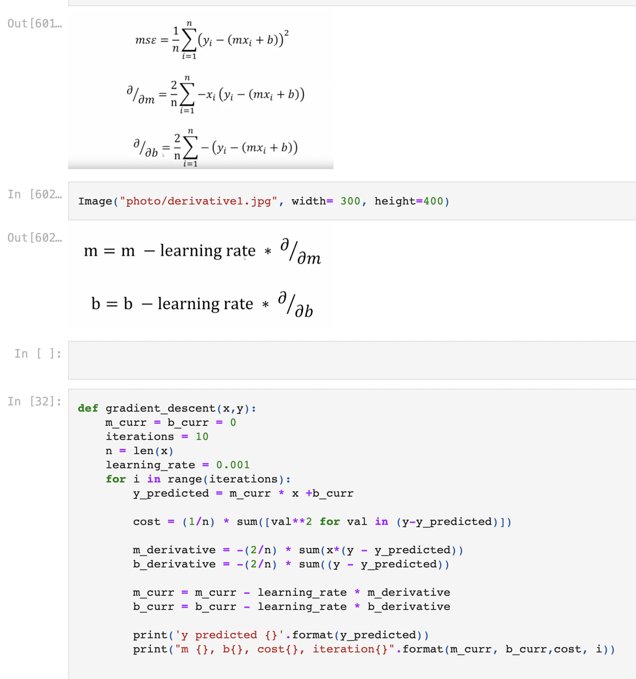
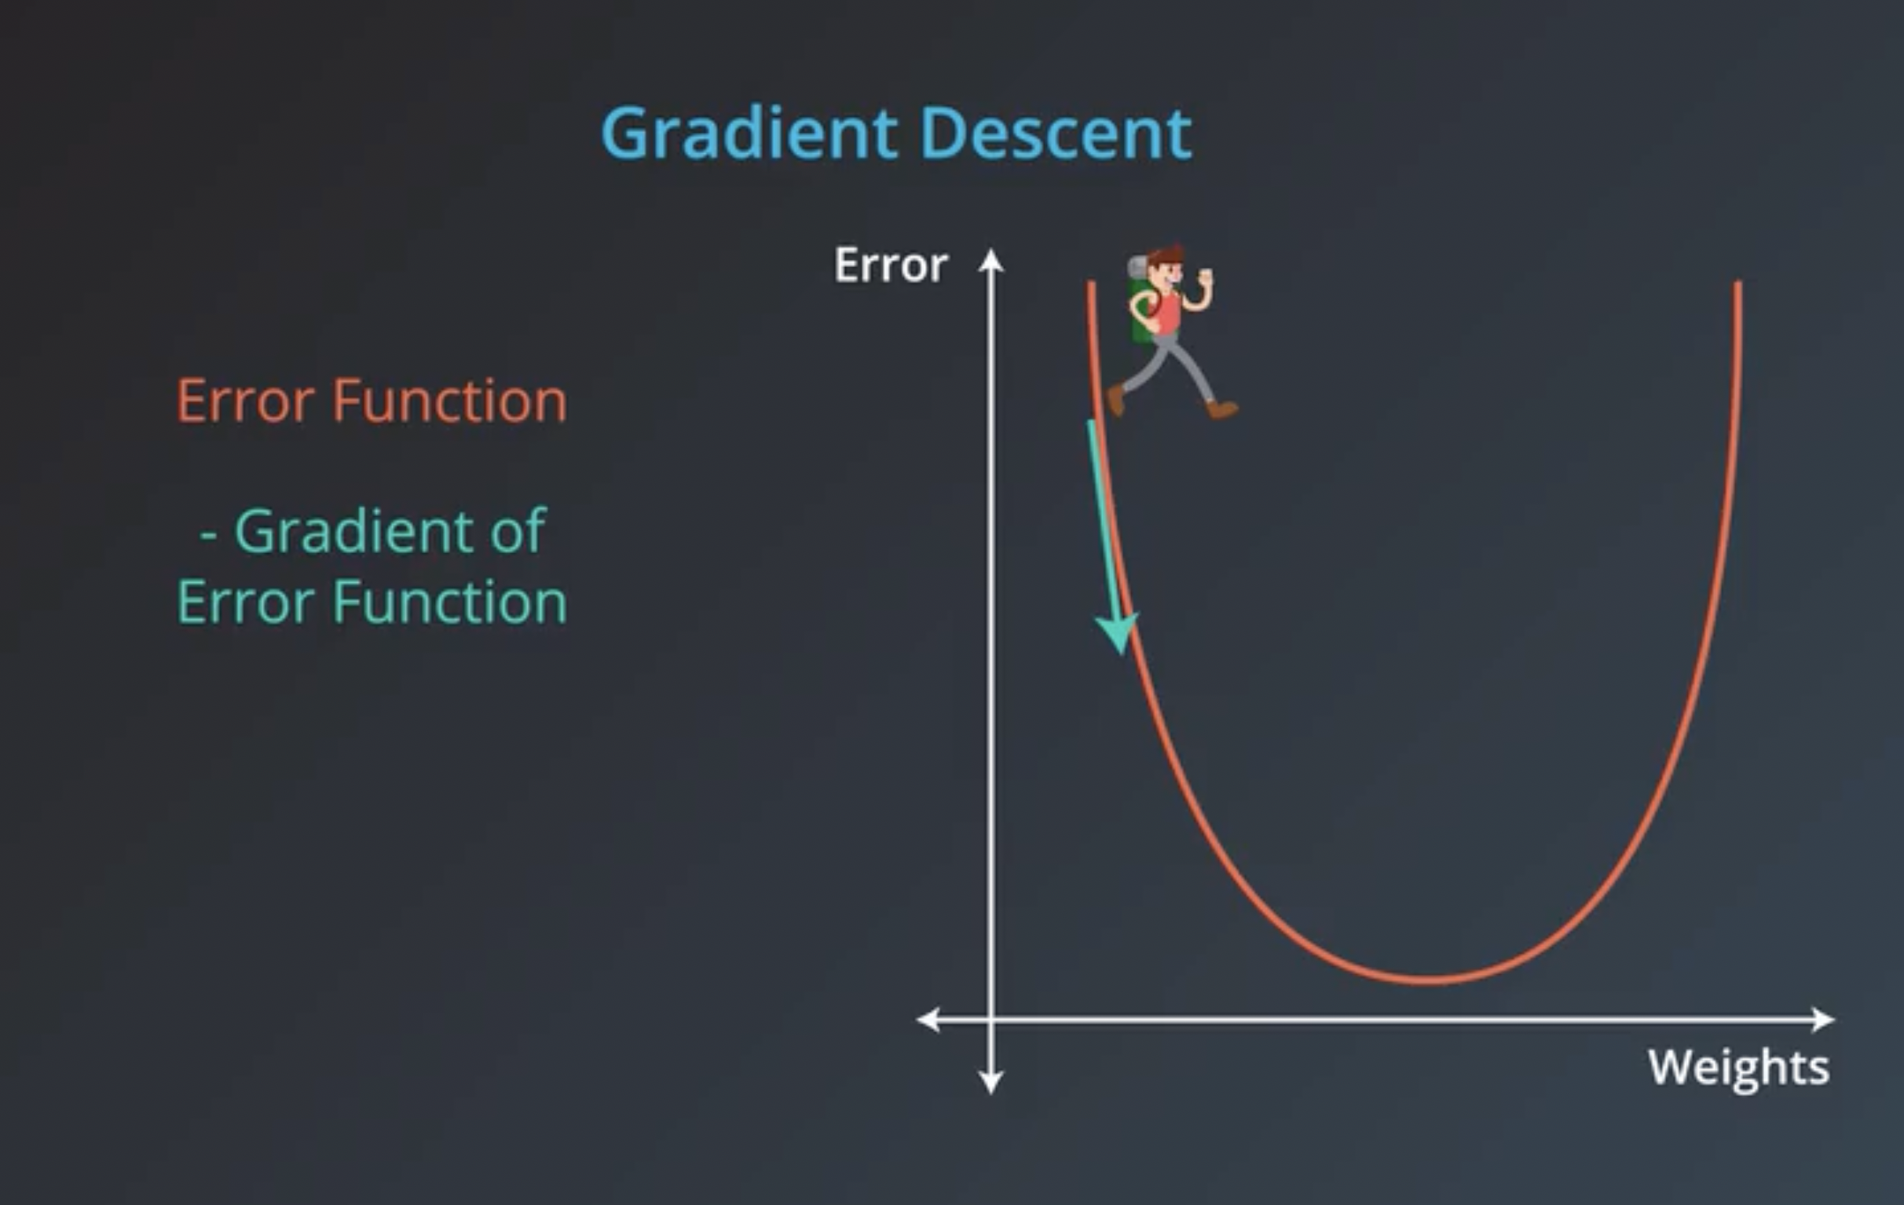
Linear regression
Notes:
Our goal is to minimize this error to obtain the most accurate value of weights
Mean squared error (MSE)
A gradient measures how much the output of a function changes if you change the inputs a little bit." — Lex Fridman
A gradient simply measures the change in all weights with regard to the change in error. You can also think of a gradient as the slope of a function. The higher the gradient, the steeper the slope and the faster a model can learn. But if the slope is zero, the model stops learning. In mathematical terms, a gradient is a partial derivative with respect to its inputs.
https://builtin.com/data-science/gradient-descent

Slide 3
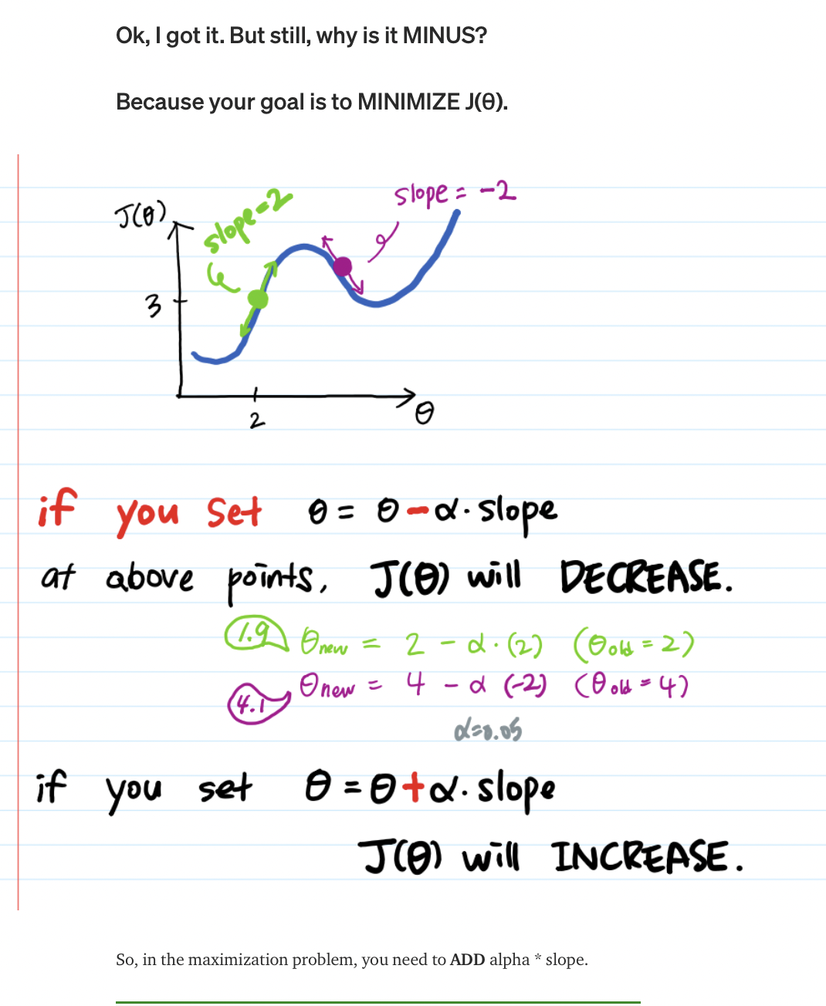
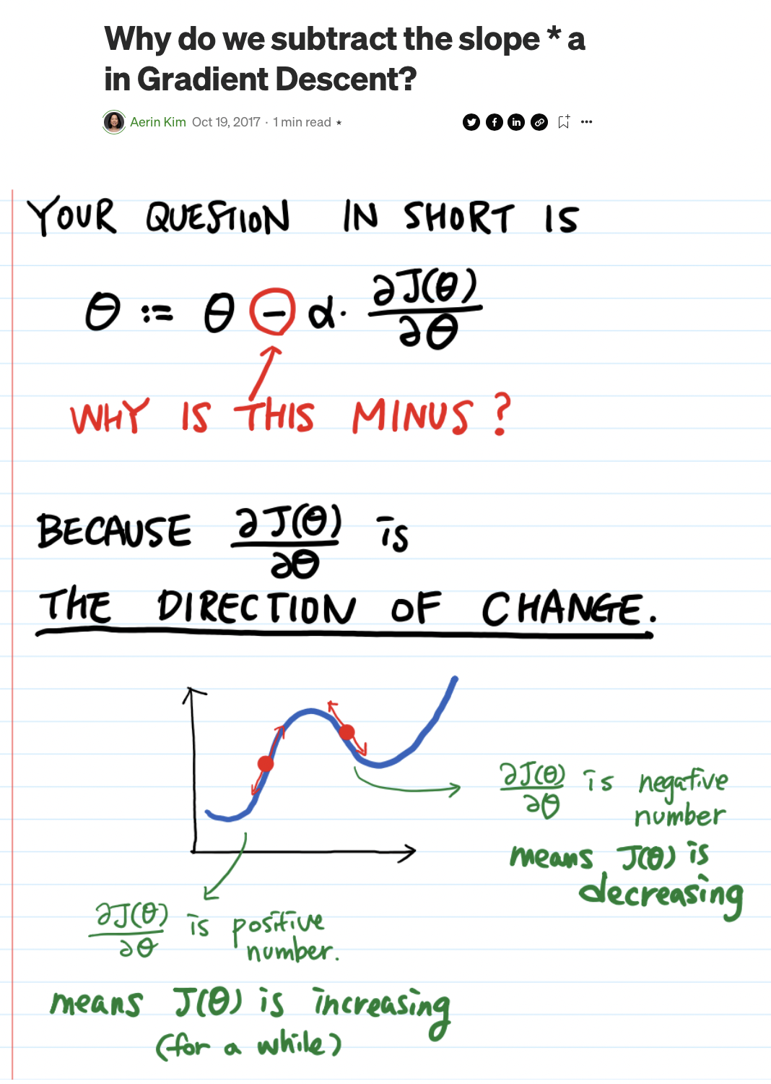
Why substract?
Notes:
https://automata88.medium.com/why-do-we-subtract-the-slope-a-in-gradient-descent-73c7368644fa

Slide 4
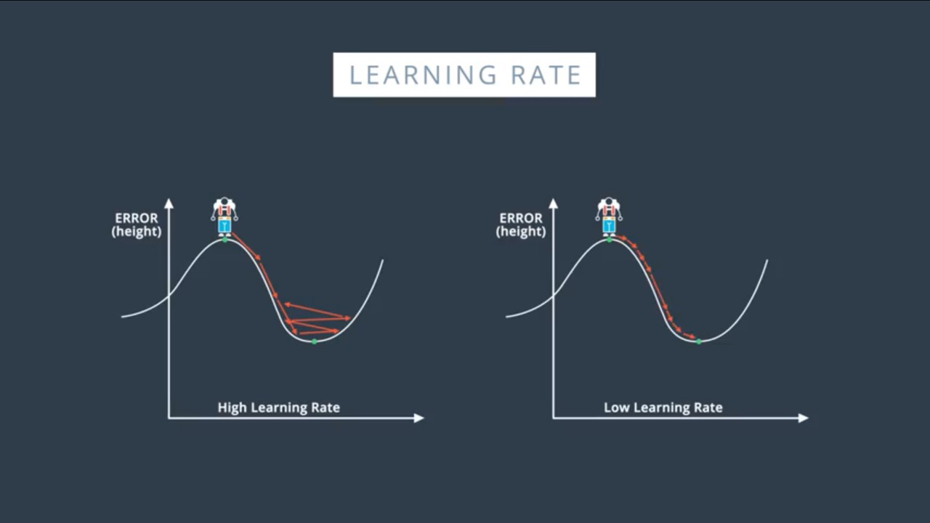
Learning Rate
Learning Rate
More time to reach local/global minima
Learning Rate
Might not reach to minima
Good starting point : 0.01

Slide 5
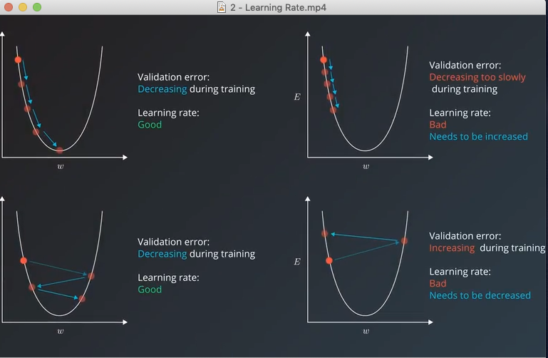
Learning Rate

Slide 6
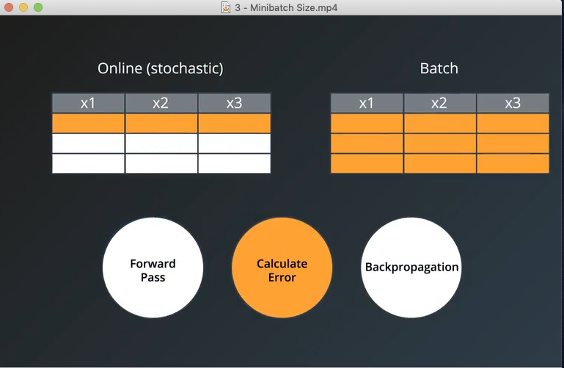
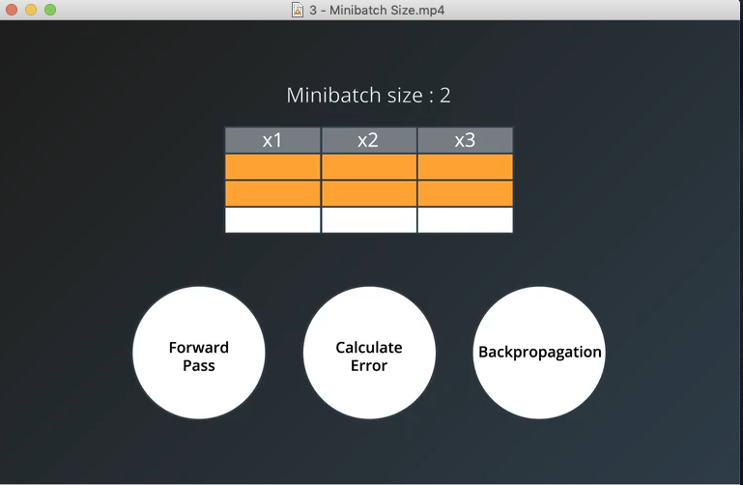
Batch

Slide 7
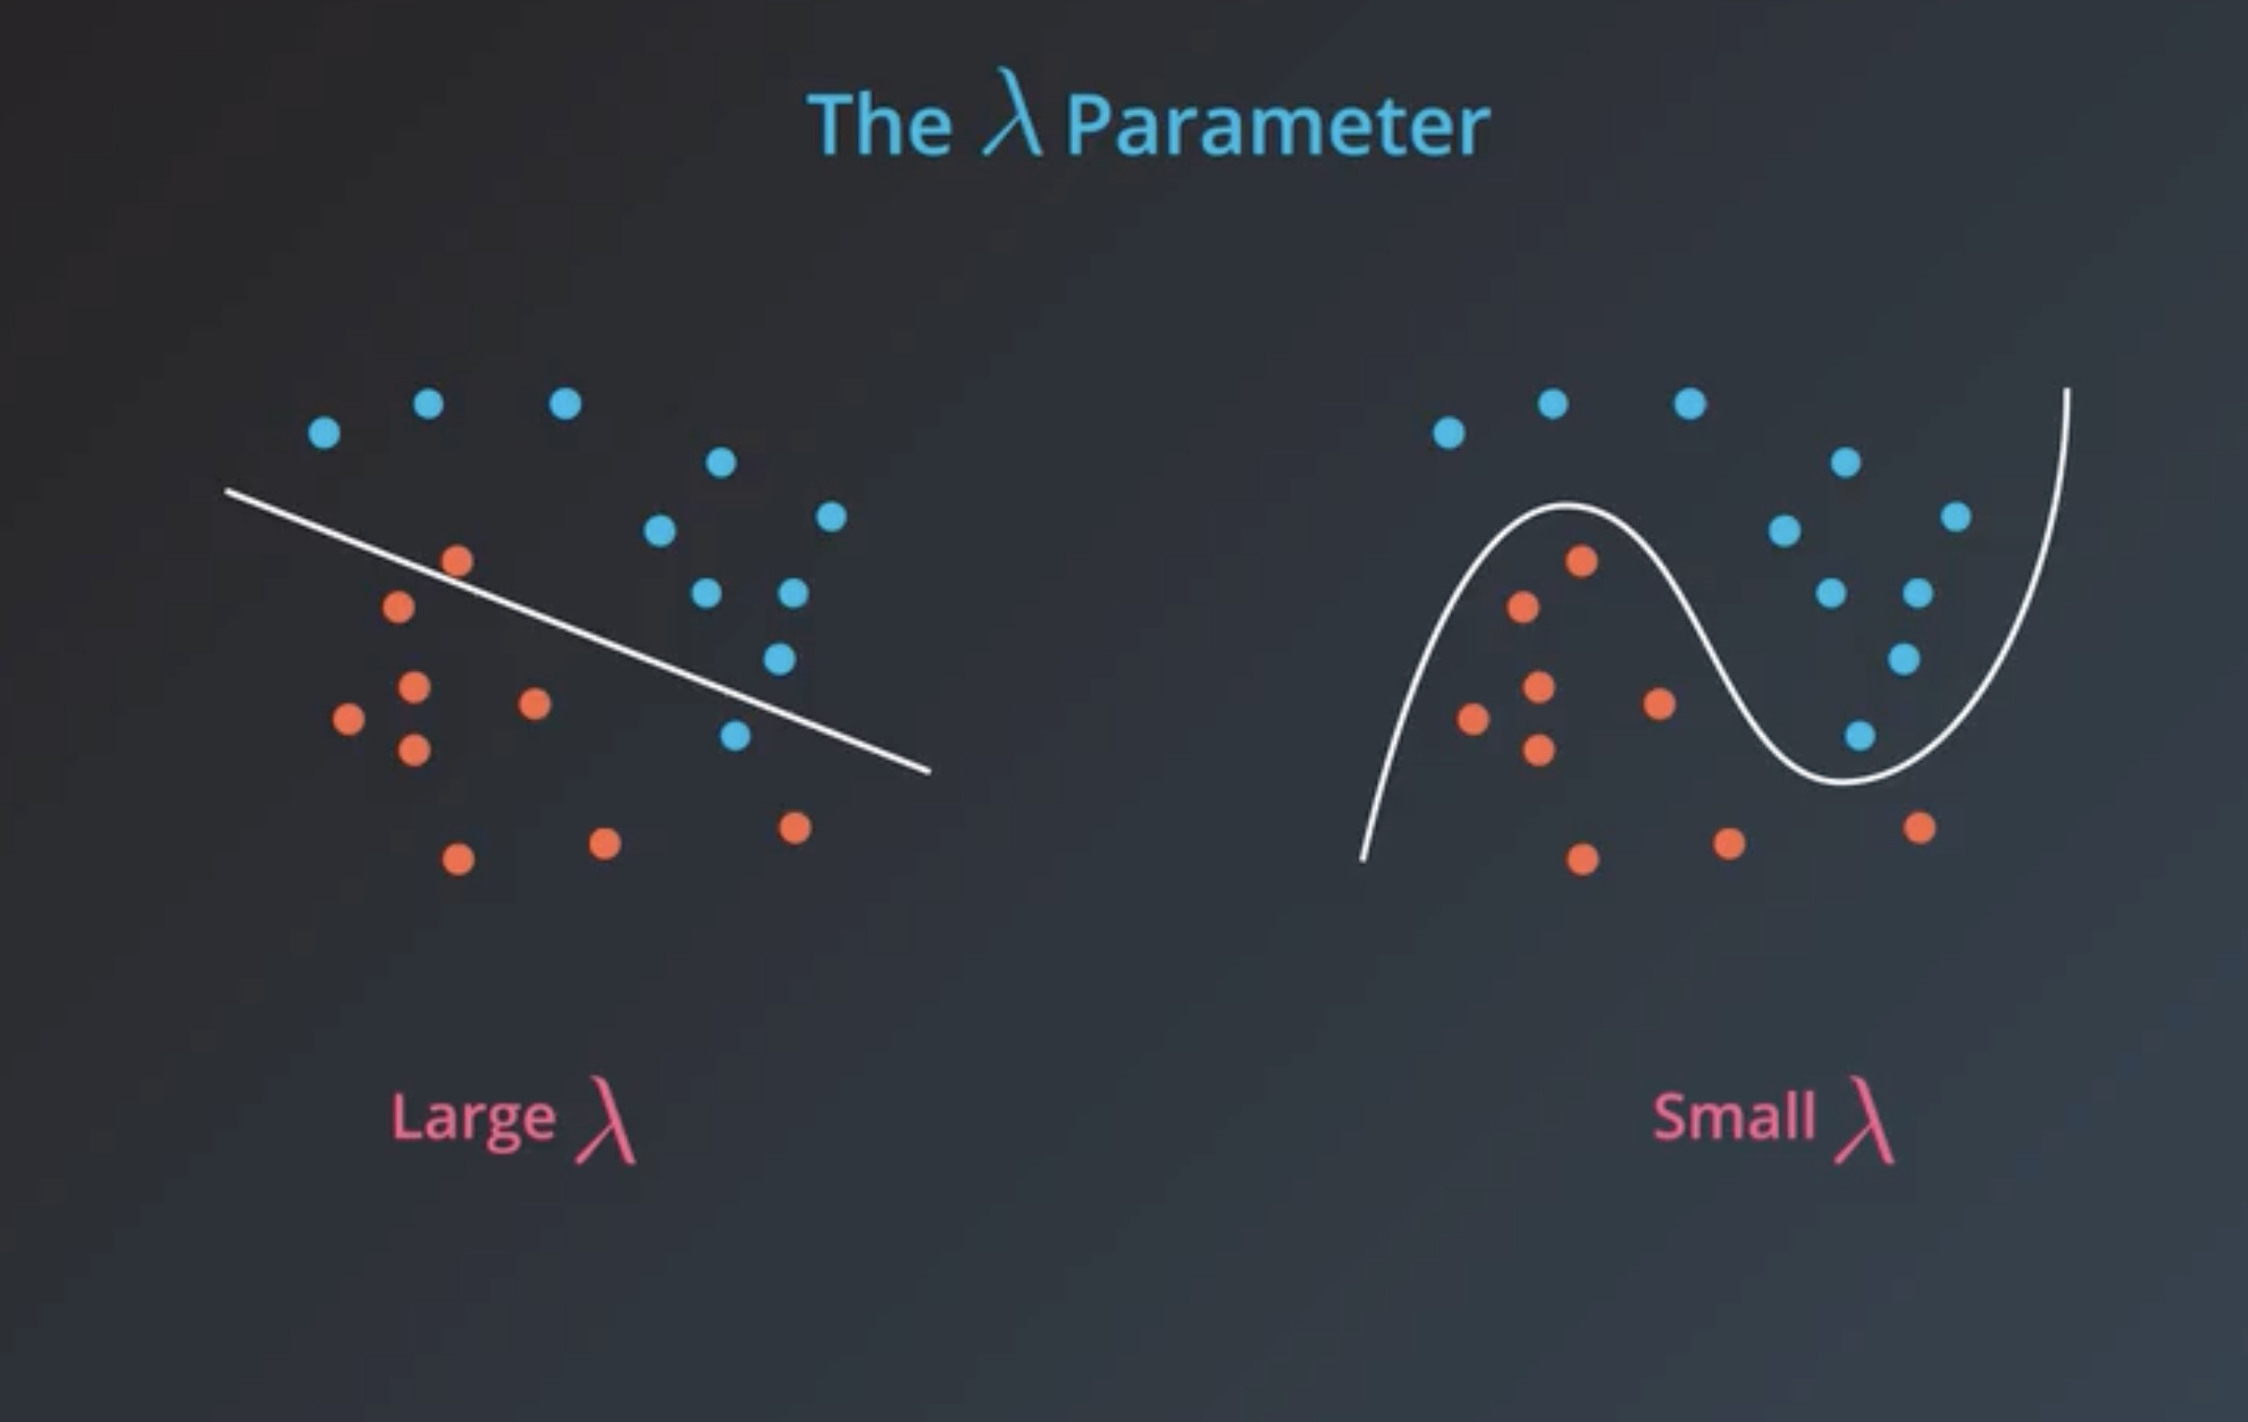
Regularization
Notes:
If we want simpler model, we choose large lambda, and penalize more-
If we want complex model, we choose small lambda, penalize less
L1- lasso
L2- ridge

Slide 8
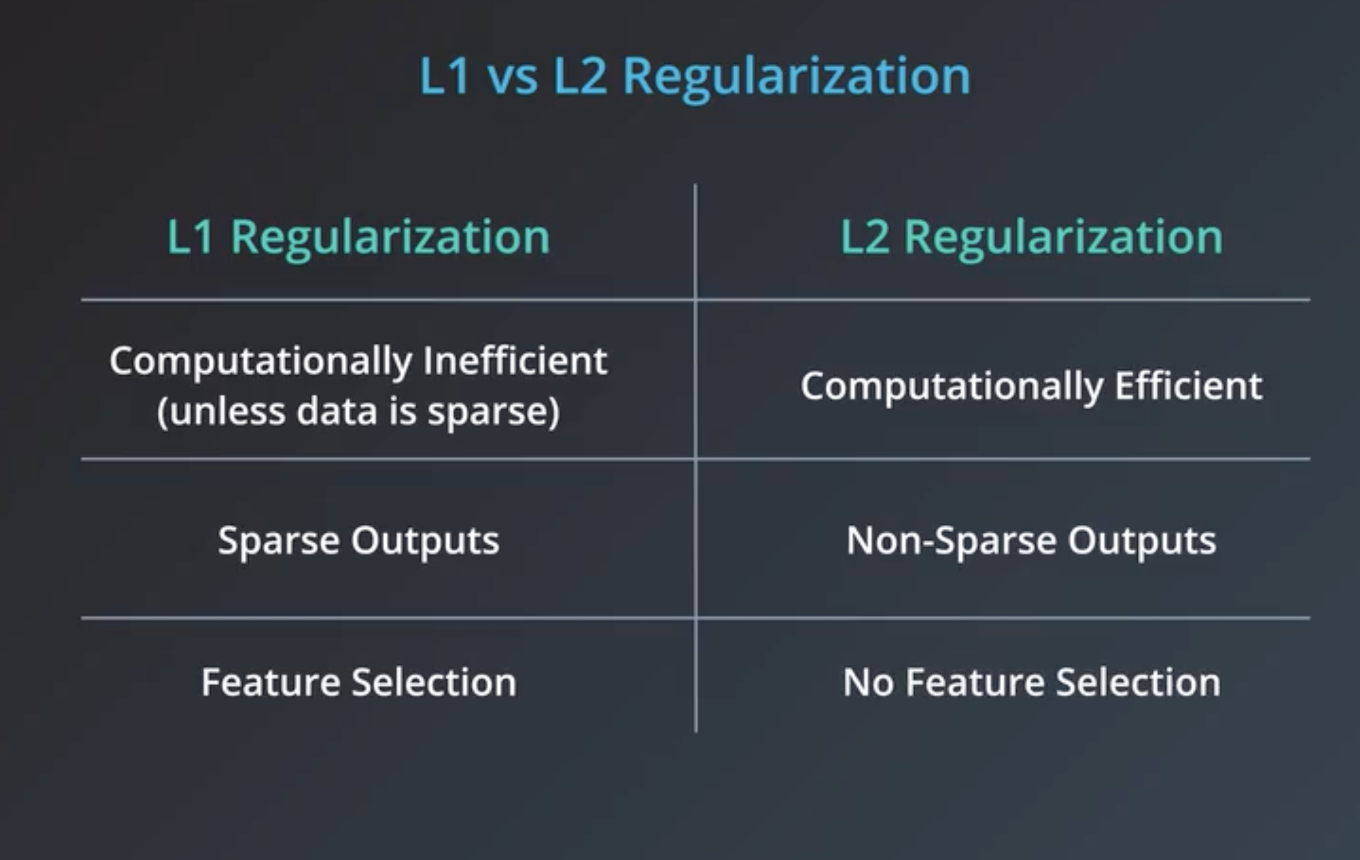

Slide 9
Logistic Regression

Slide 11
Naïve Bayes

Slide 13
Decision Tree
A decision tree is a machine learning model that builds upon iteratively asking questions to partition data and reach a solution.

Slide 14
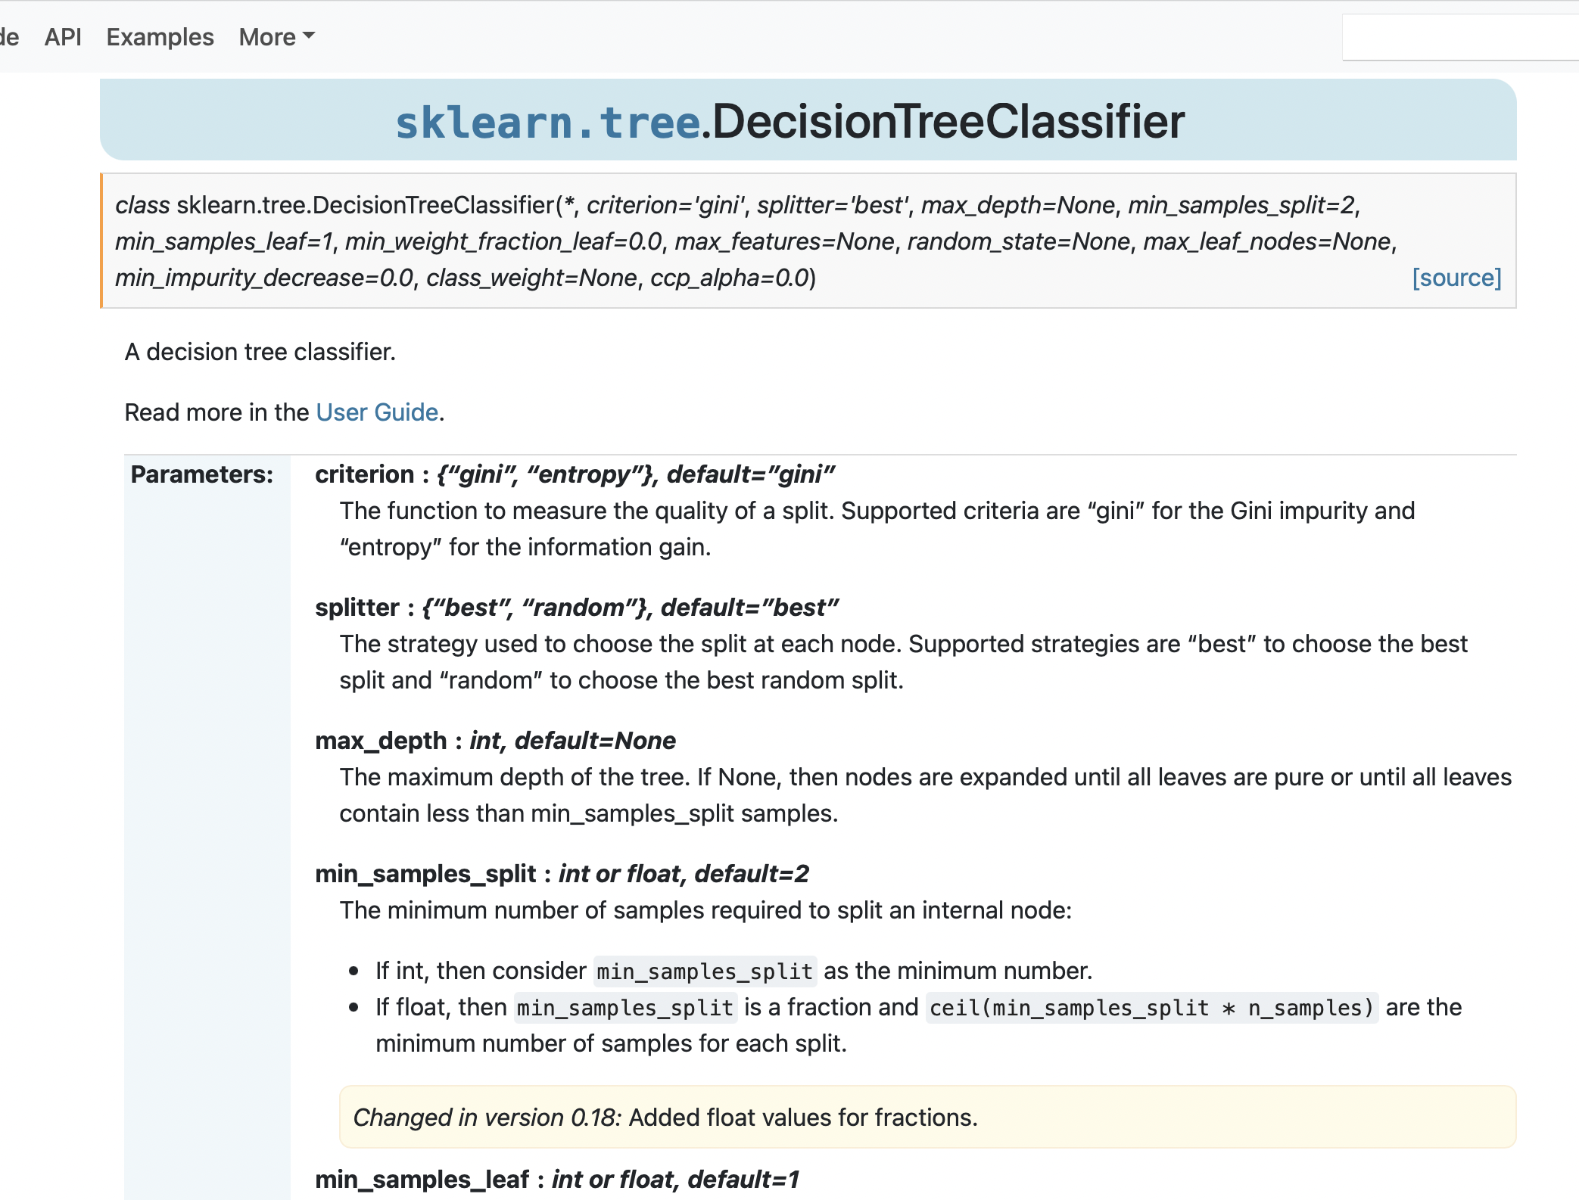

Slide 15
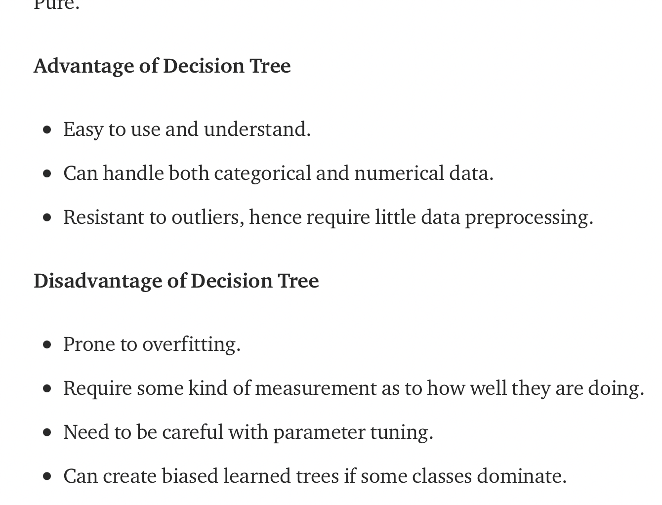
Decision Tree
Notes:
https://towardsdatascience.com/decision-tree-in-machine-learning-e380942a4c96

Slide 16
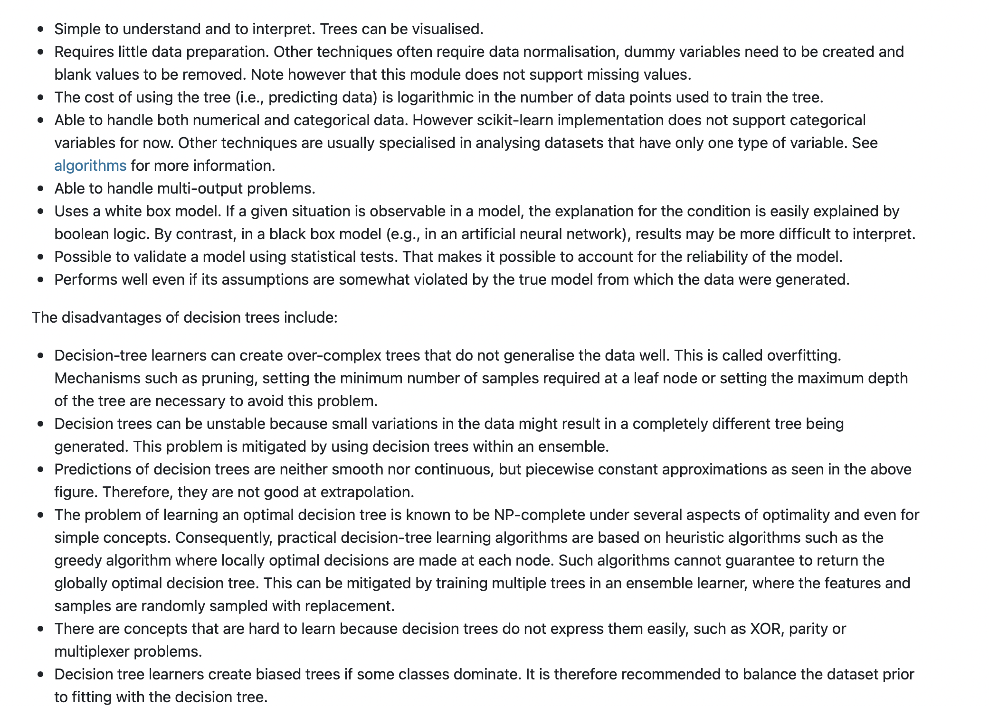
Decision Tree
Notes:
https://scikit-learn.org/stable/modules/tree.html

Slide 17
Decision Tree
Notes:
https://scikit-learn.org/stable/modules/tree.html

Slide 18
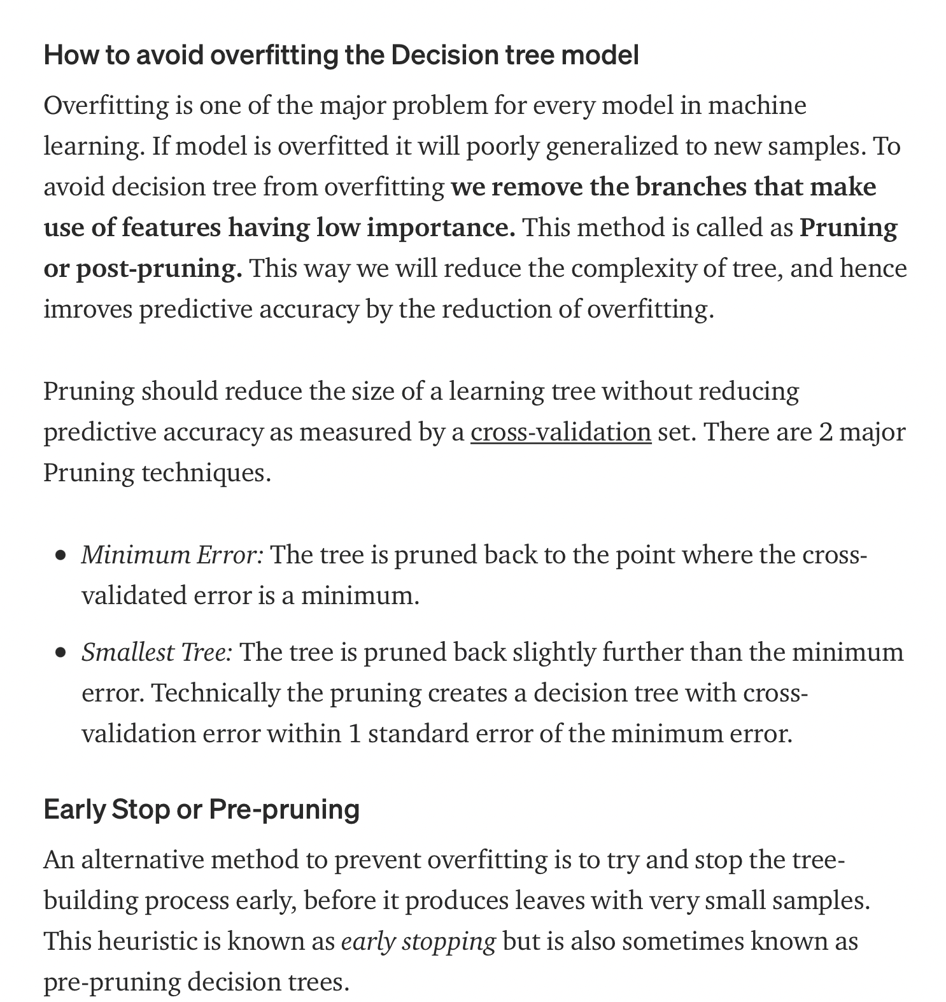
Decision Tree
Notes:
https://towardsdatascience.com/decision-tree-in-machine-learning-e380942a4c96

Slide 20
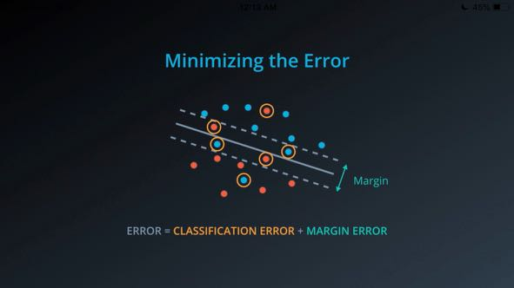
SVM

Slide 21
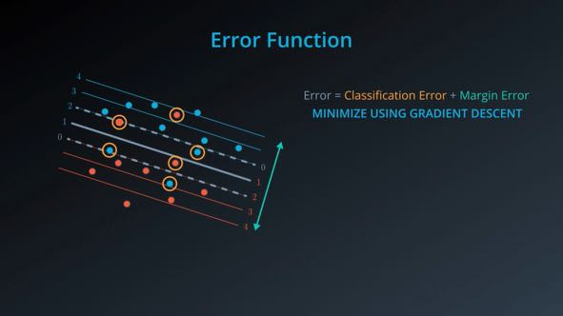

Slide 22
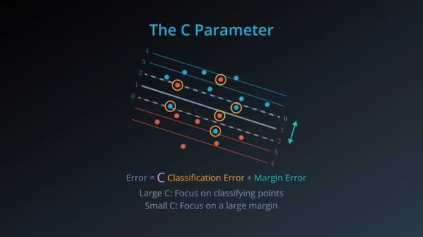

Slide 23
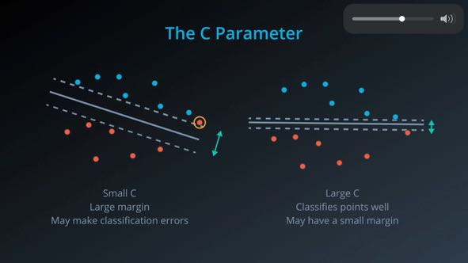

Slide 24
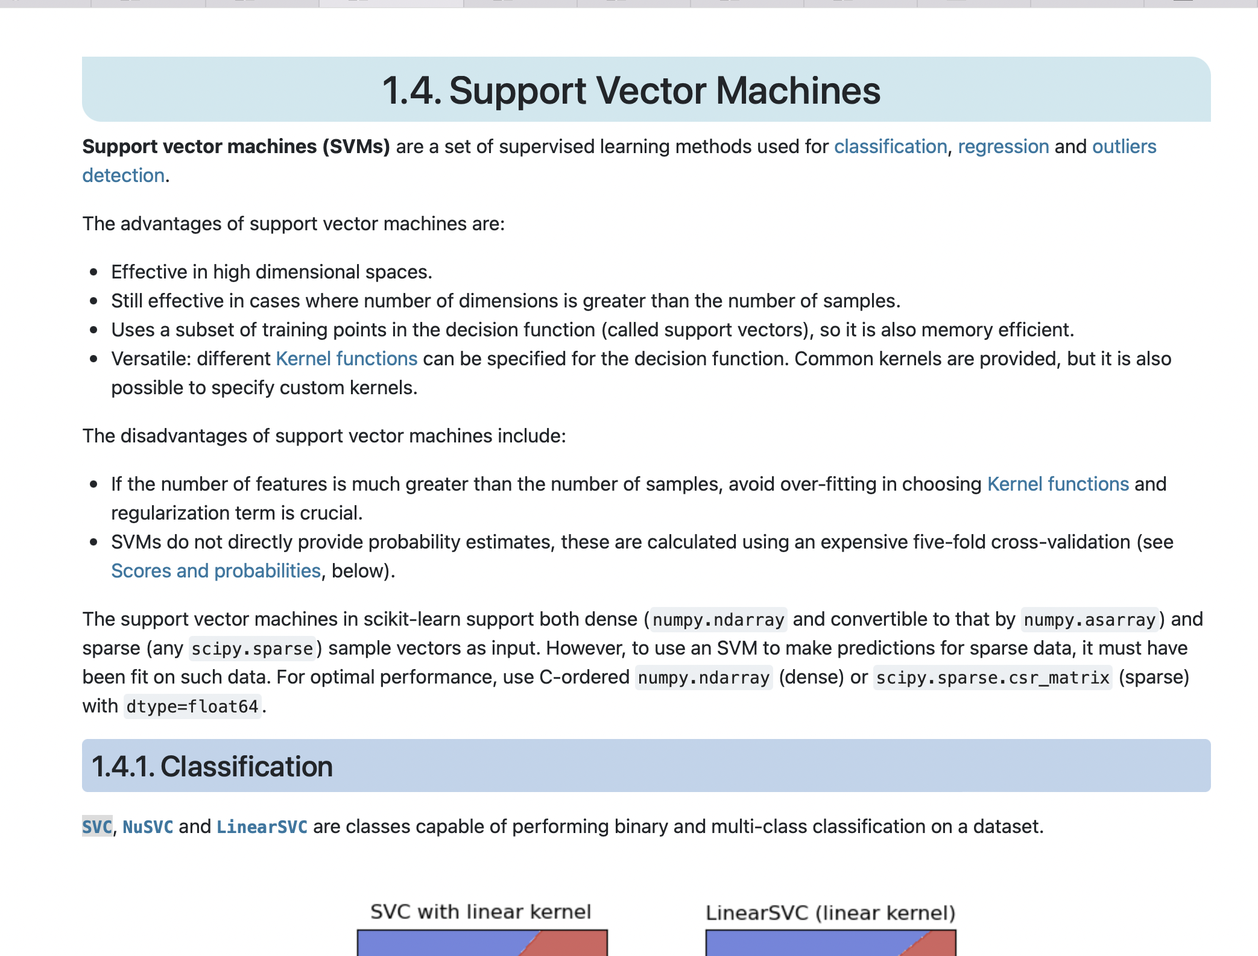
Notes:
https://scikit-learn.org/stable/modules/generated/sklearn.svm.SVC.html#sklearn.svm.SVC

Slide 25
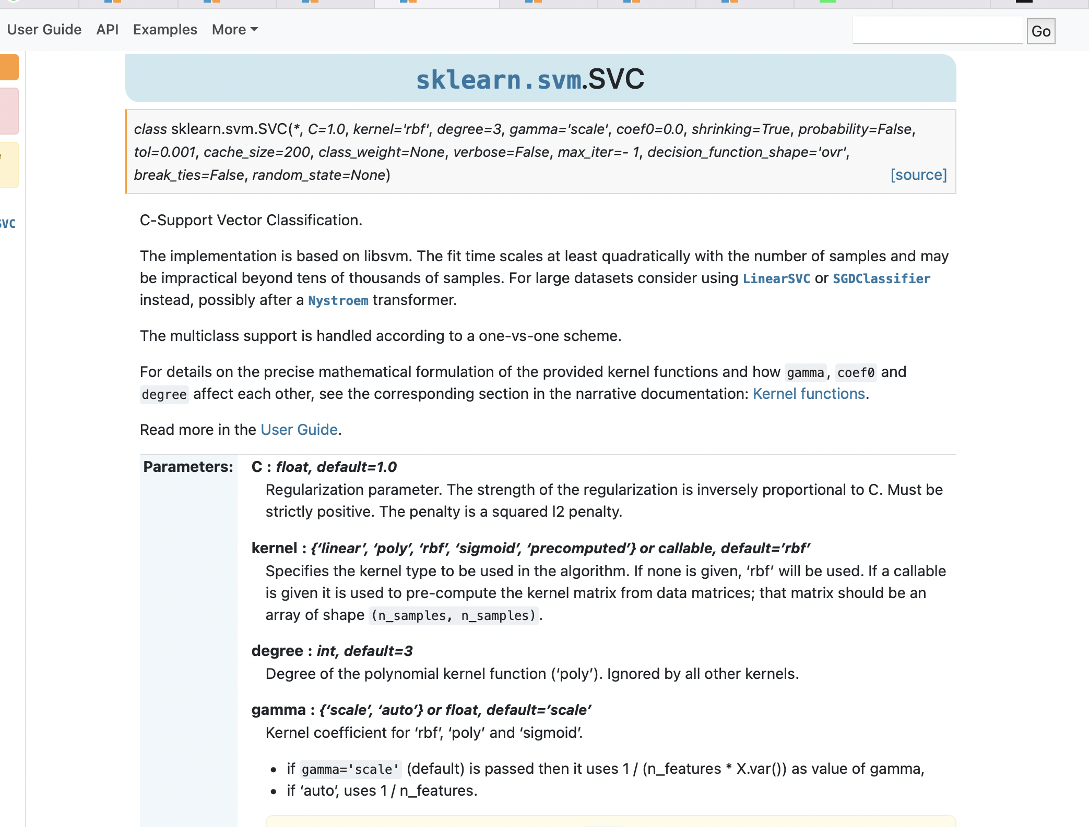
Notes:
Radial Basis Function (RBF)
Gamma is a hyperparameter in rbf

Slide 26
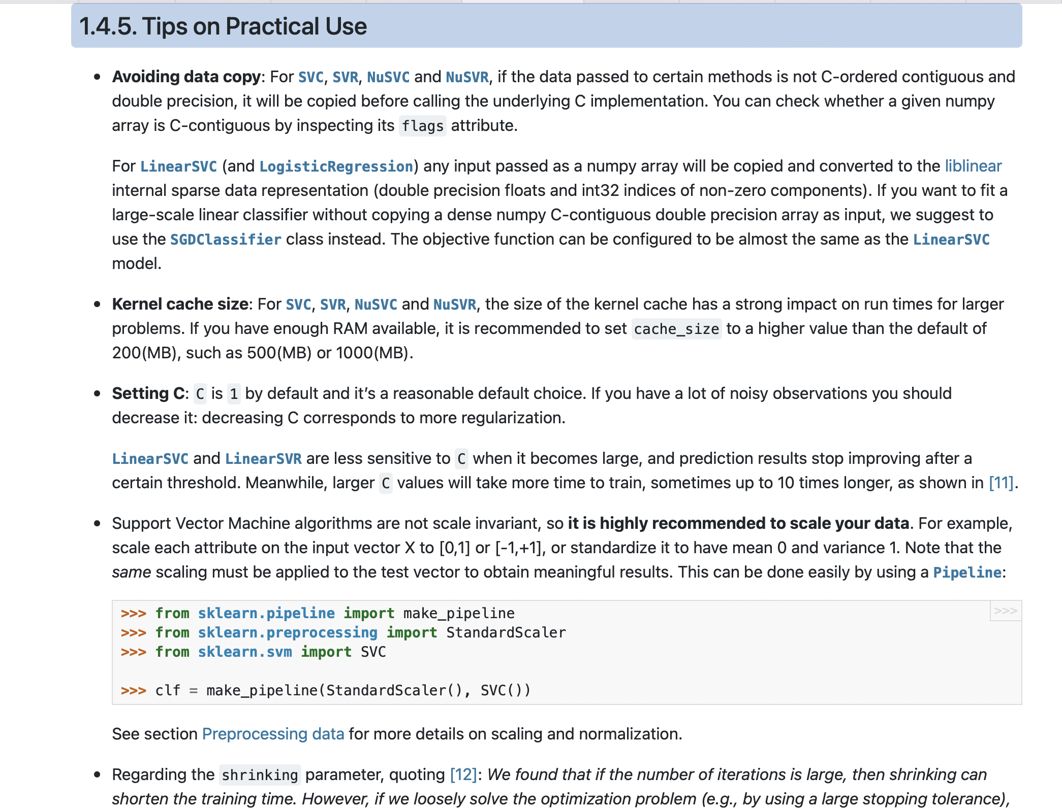

Slide 27
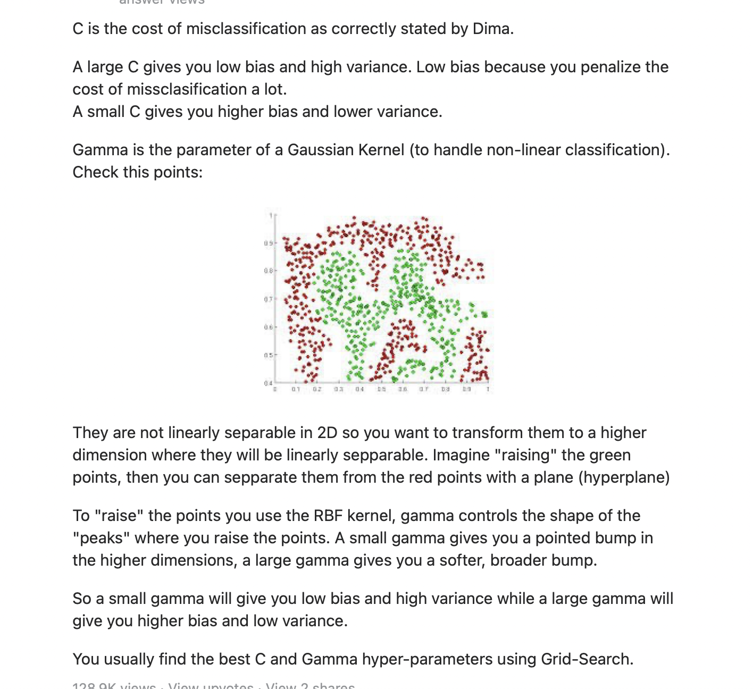

Slide 28
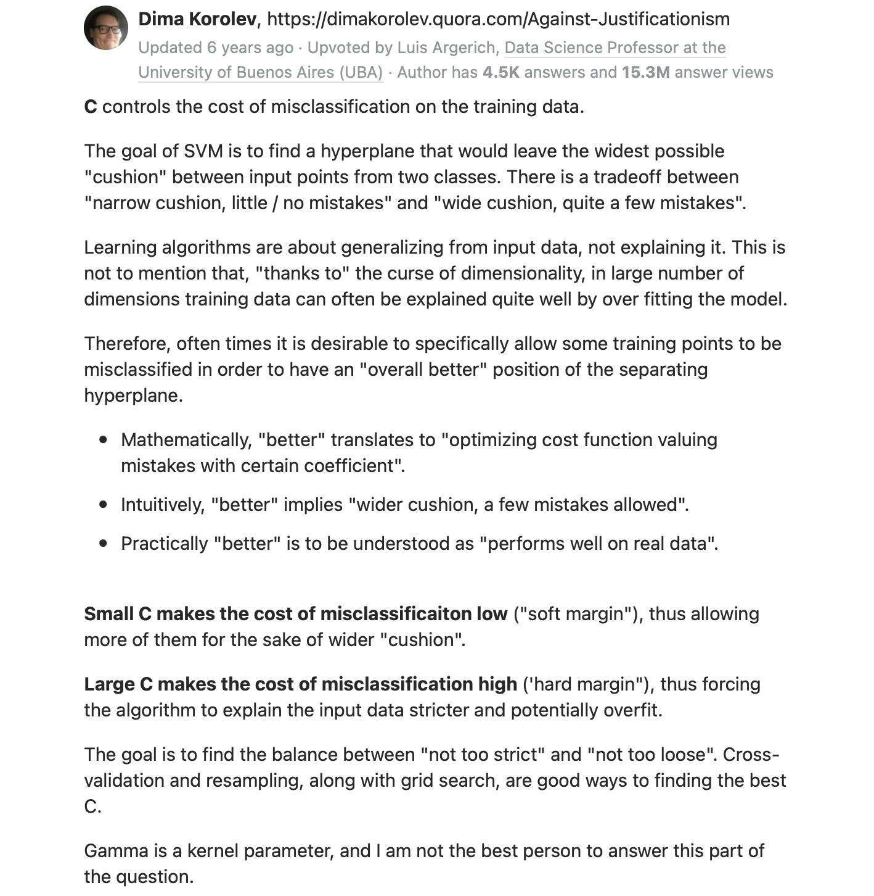

Slide 29
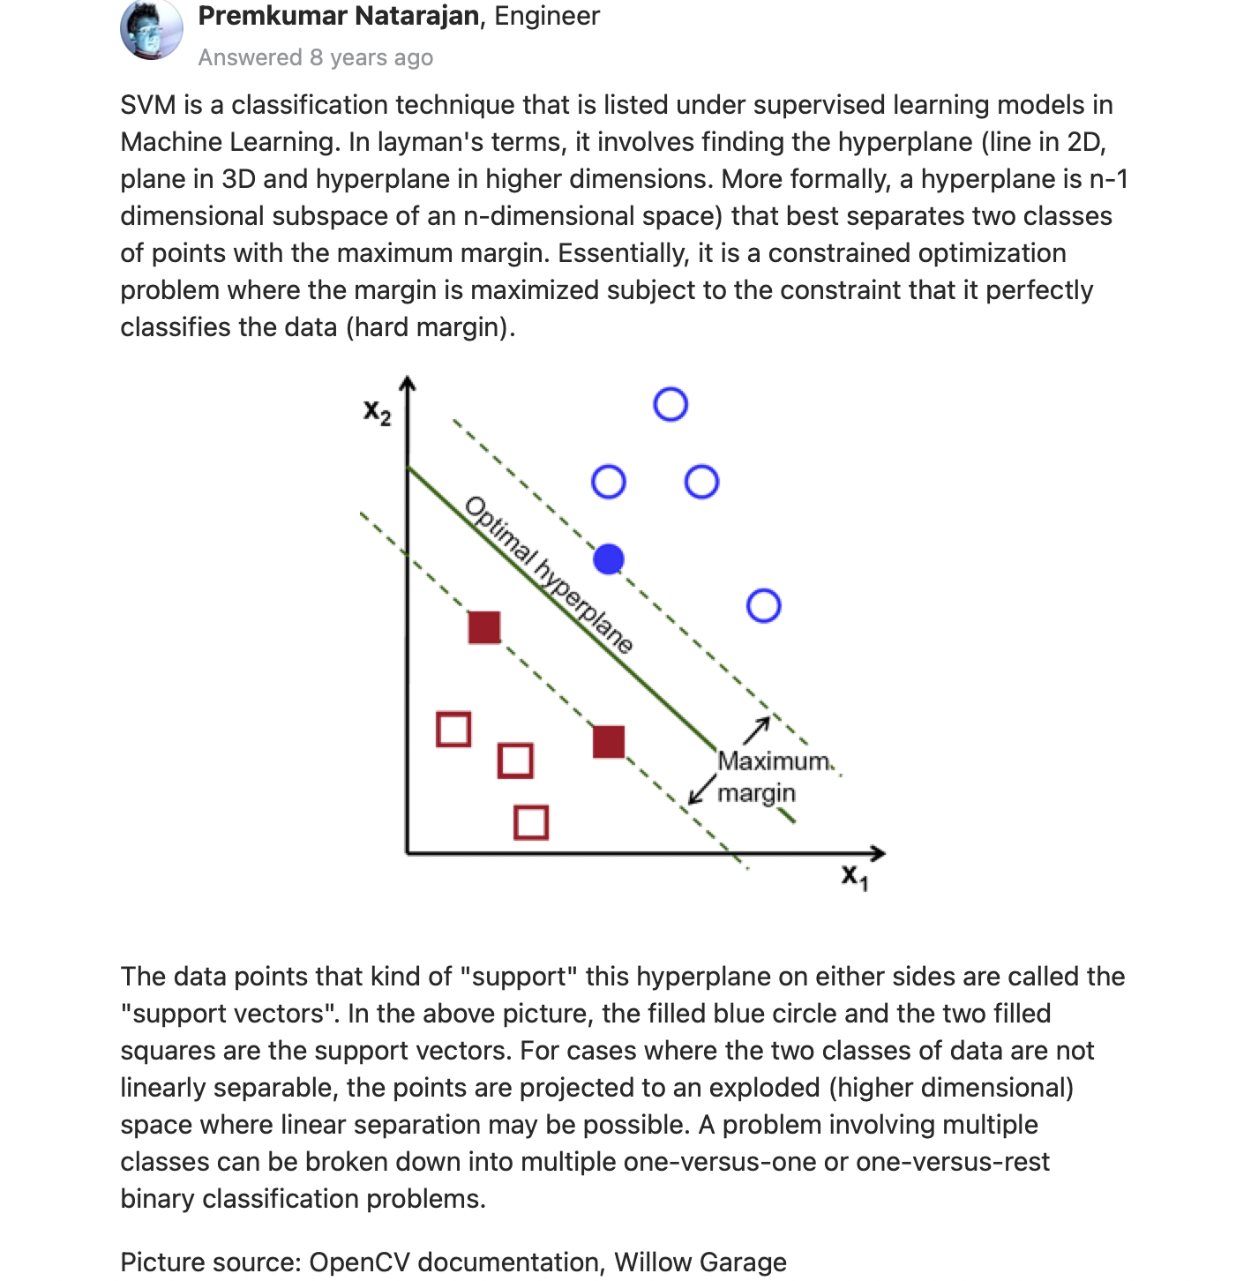

Slide 30
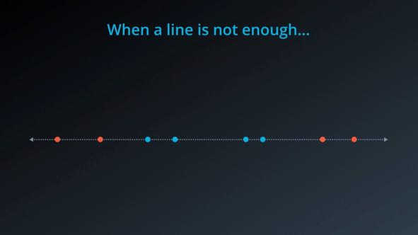
Kernel trick

Slide 31
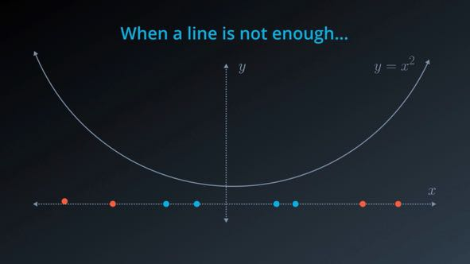

Slide 32
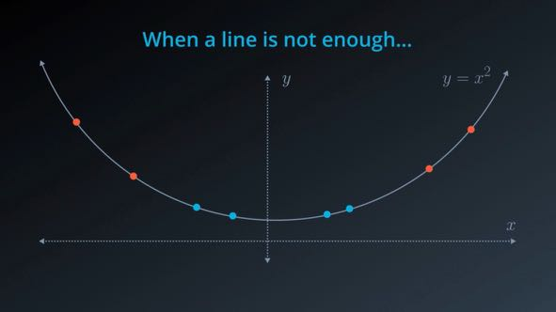

Slide 33
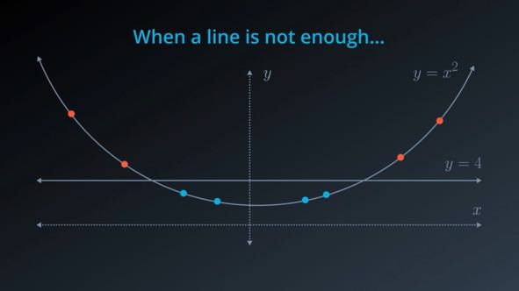

Slide 34
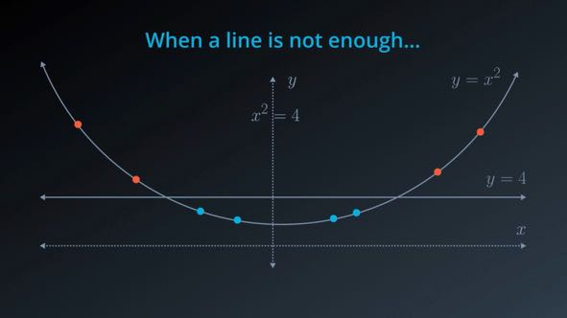

Slide 35


Slide 36
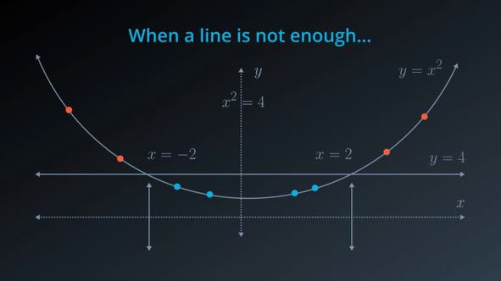

Slide 37
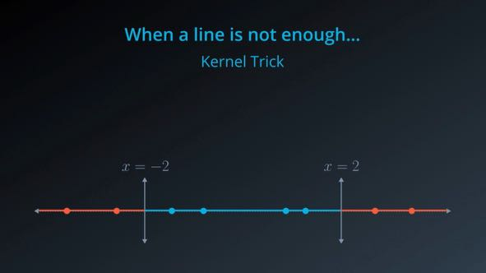

Slide 38
SVM
See stat_quest screenshot

Slide 39
Random forest
See statquest screenshot

Slide 40
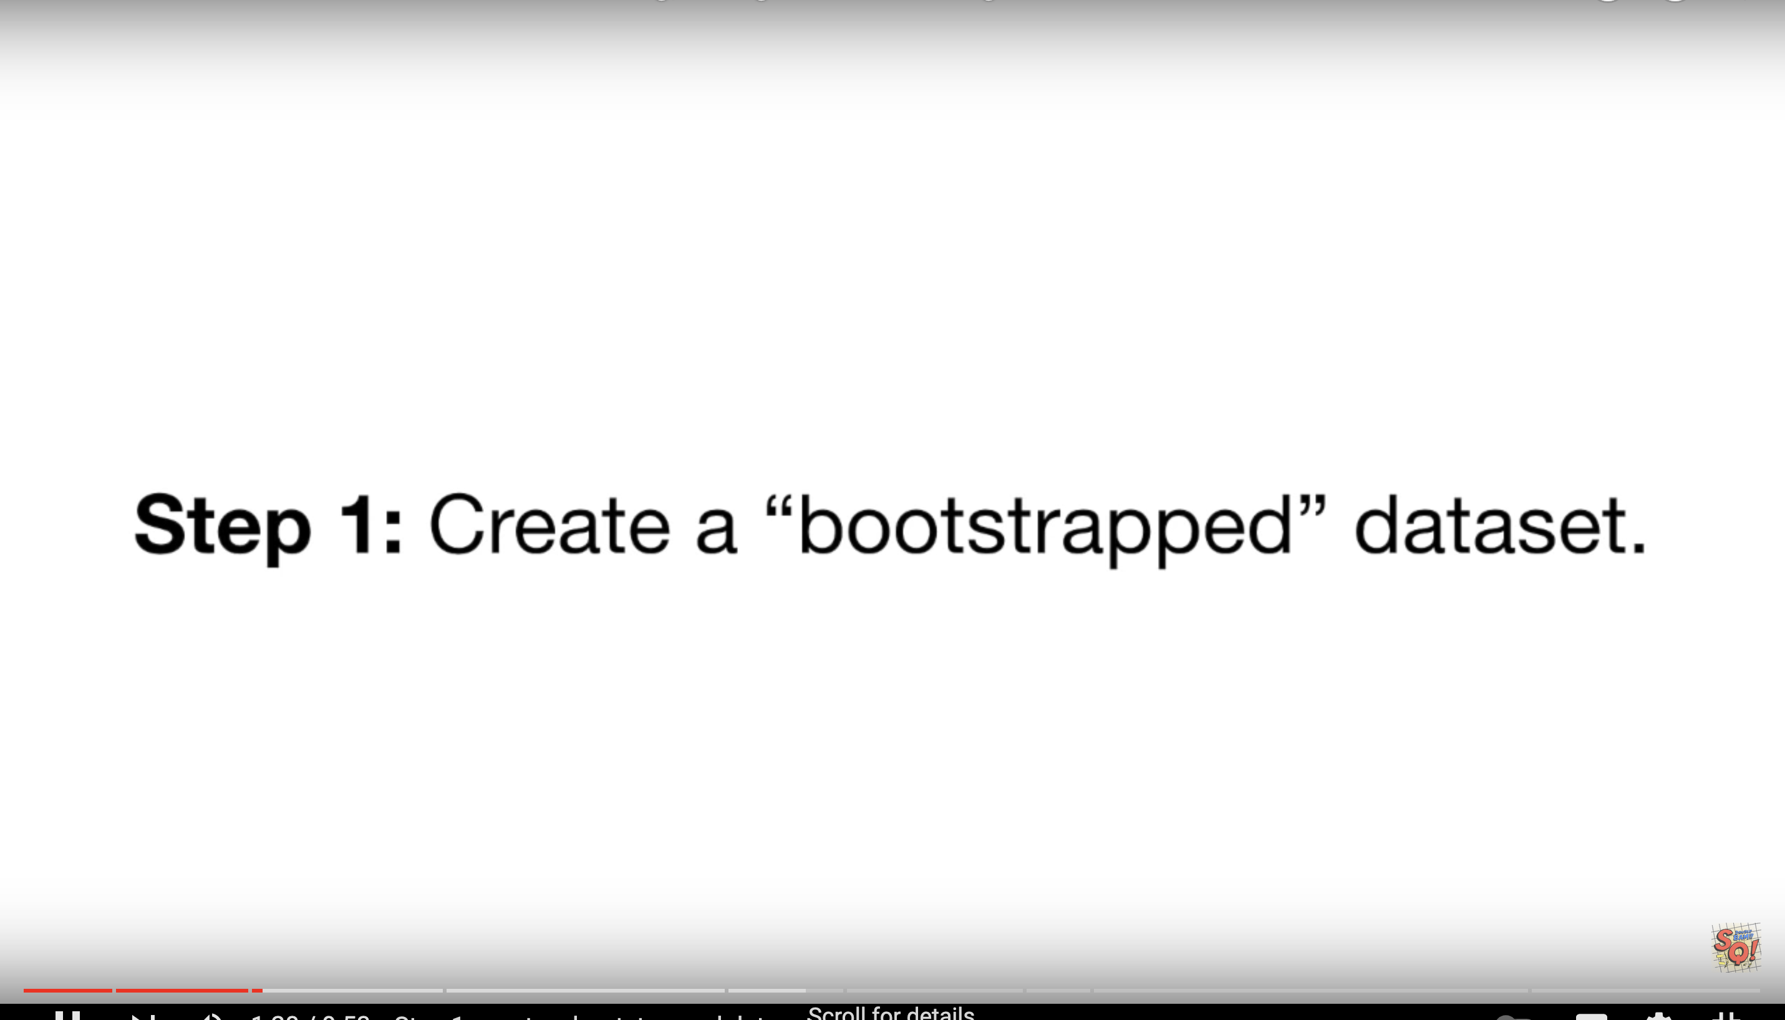

Slide 41
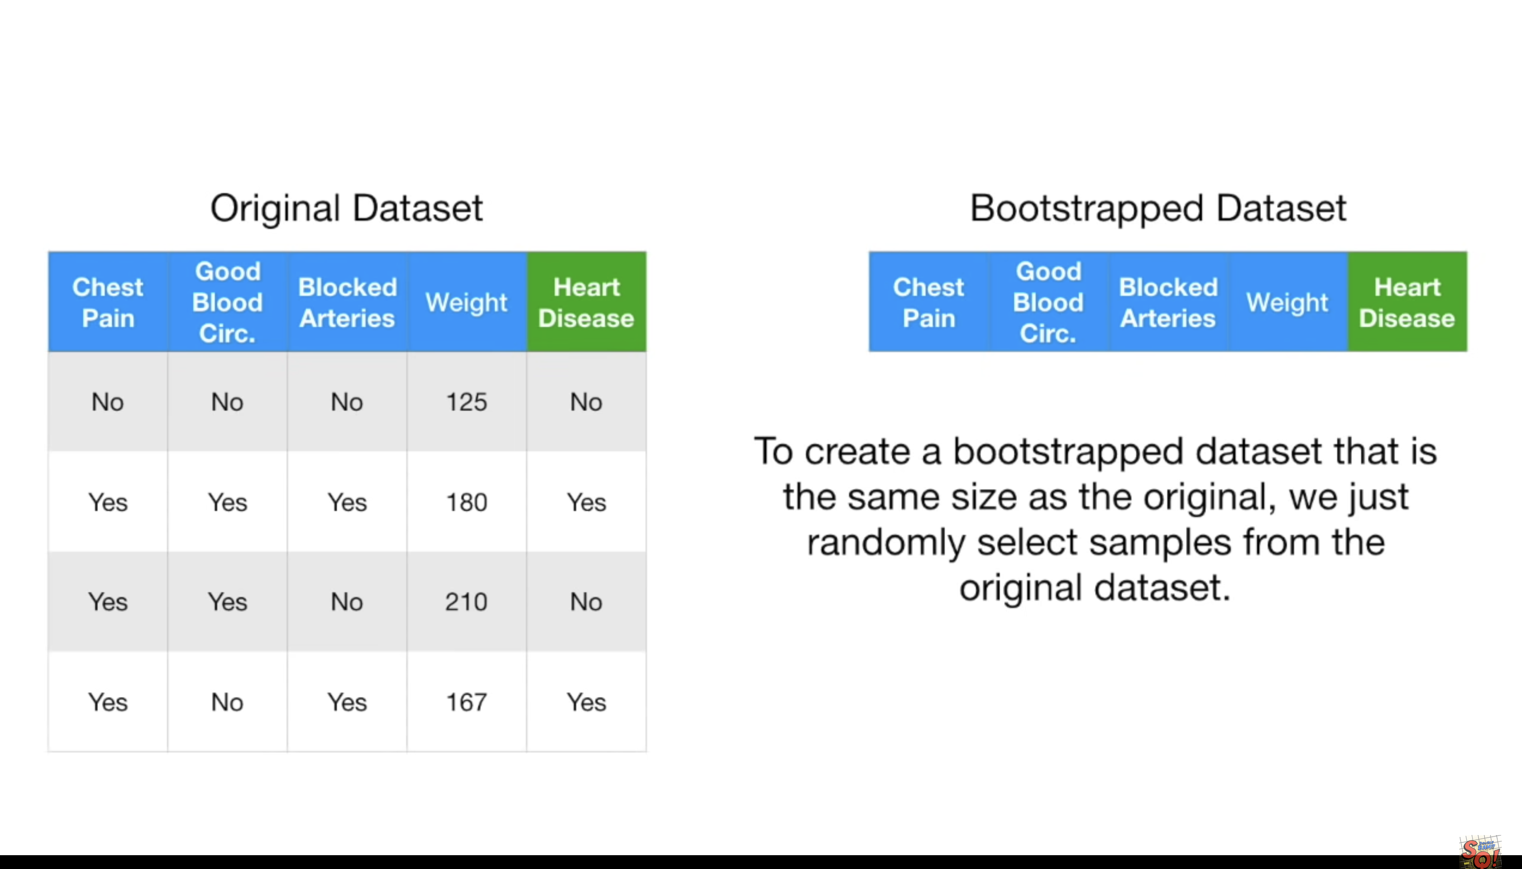

Slide 42
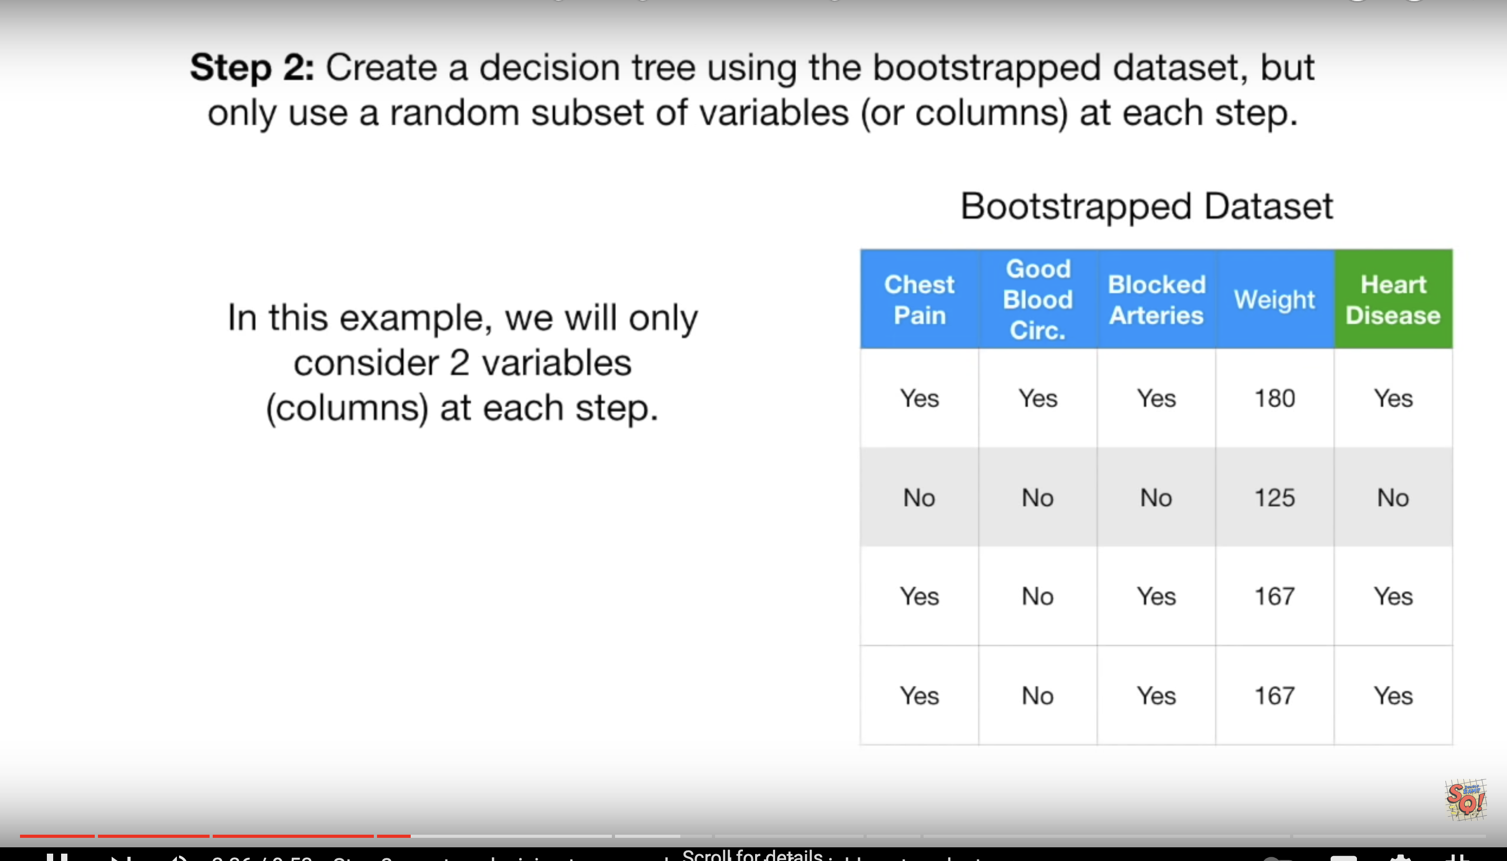

Slide 43
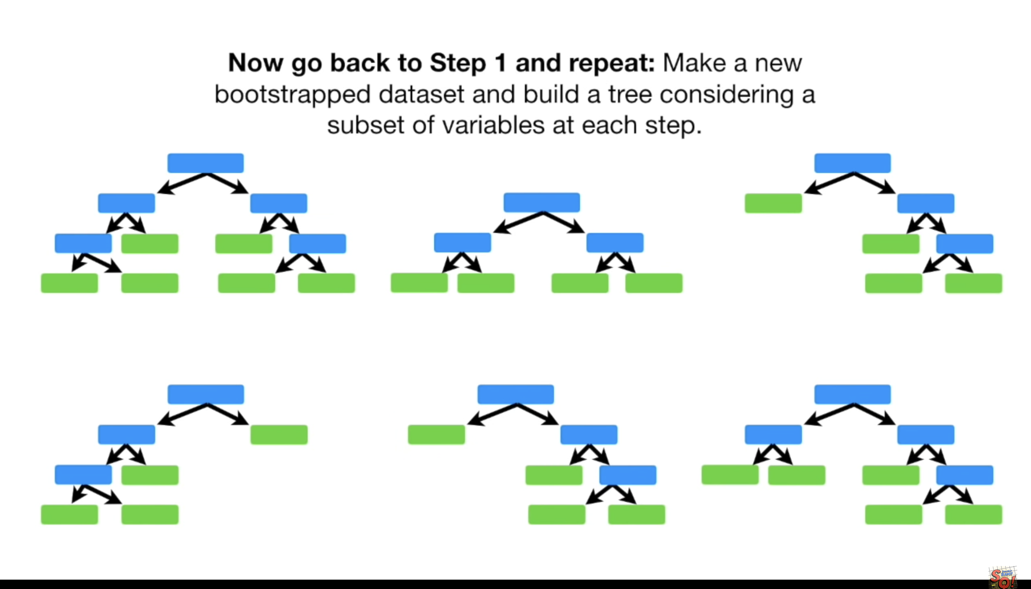

Slide 44
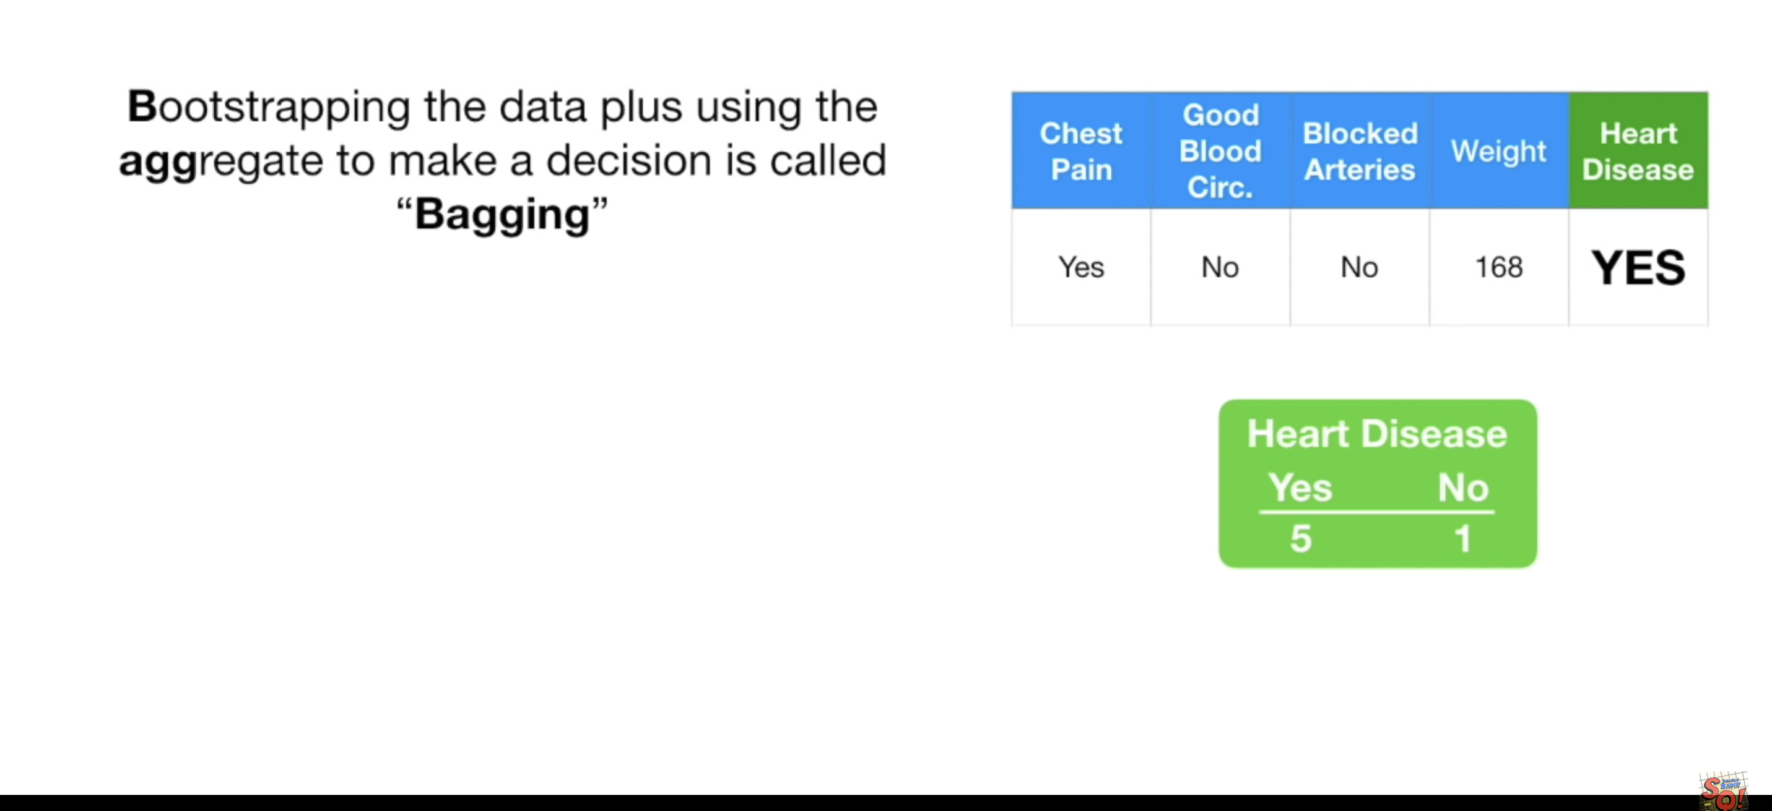

Slide 45
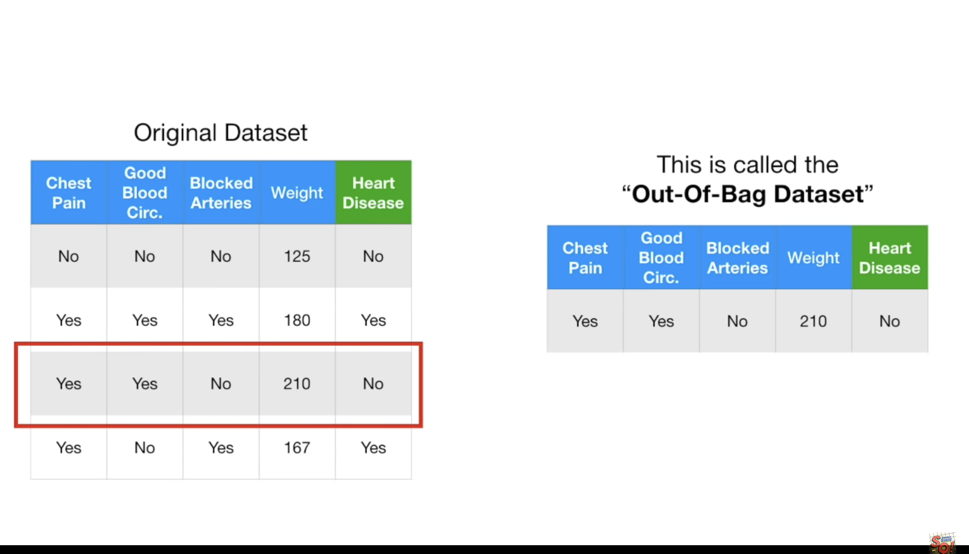

Slide 46
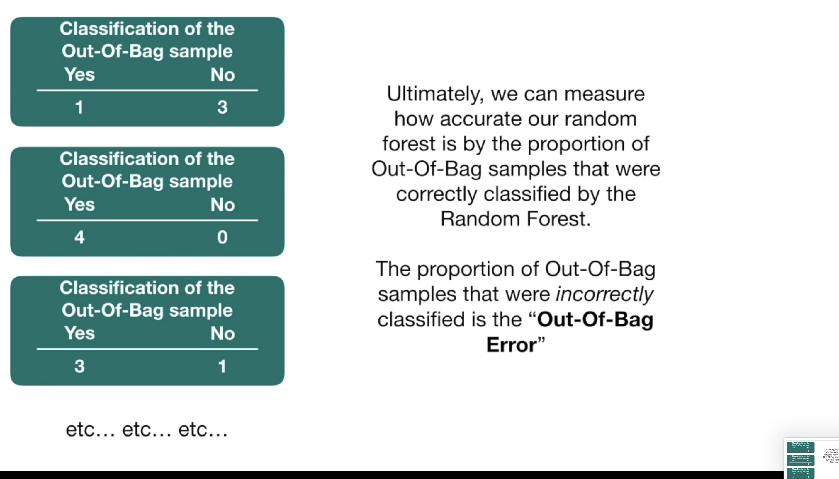

Slide 47
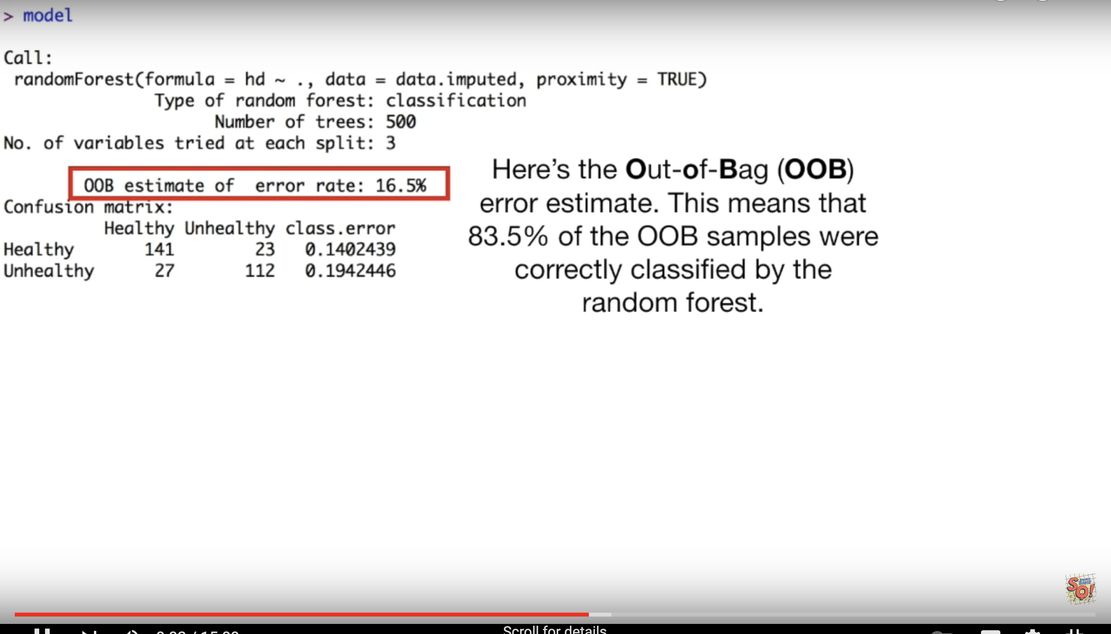

Slide 48
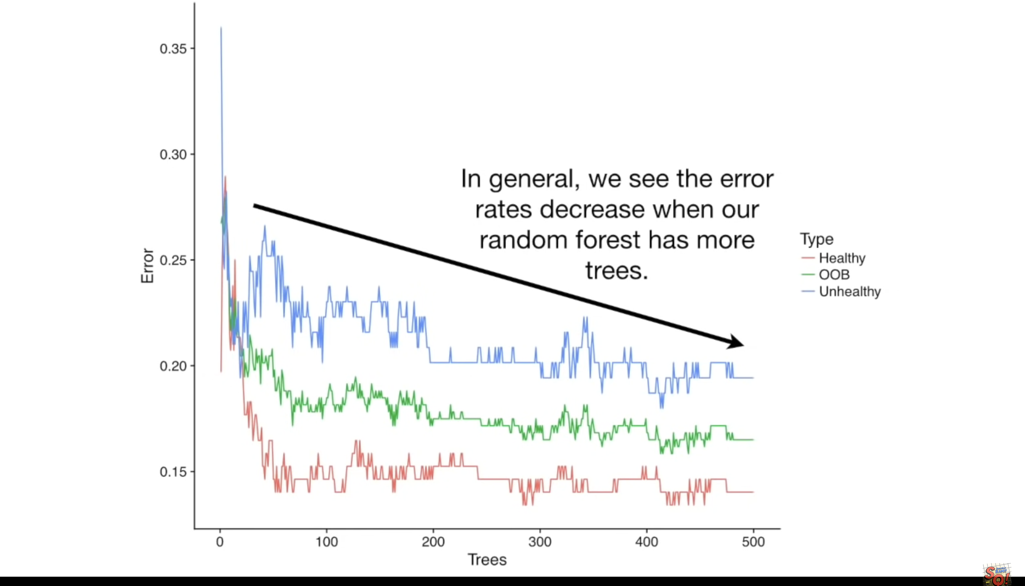

Slide 49
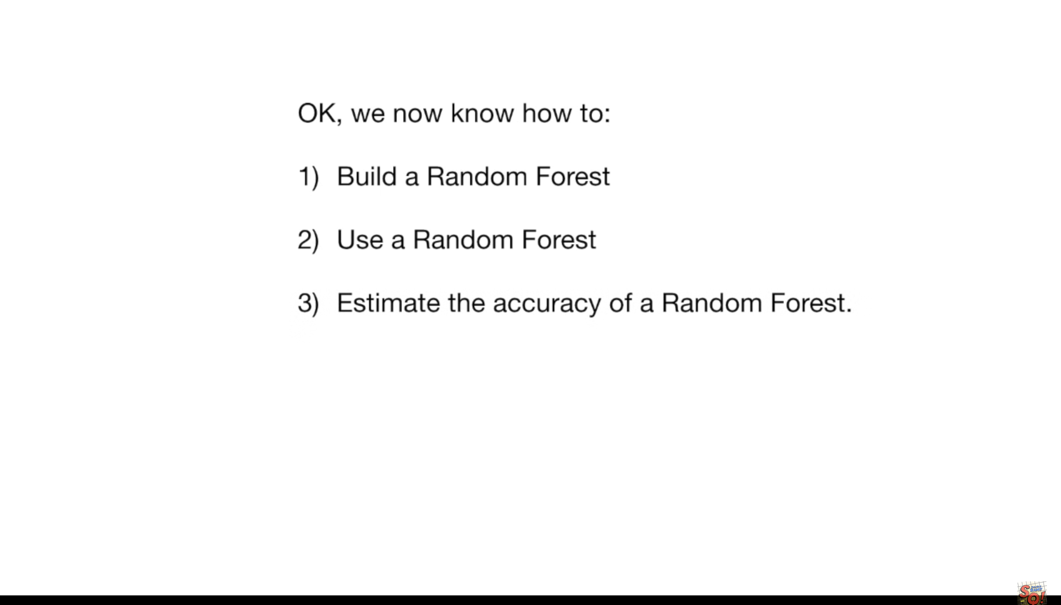

Slide 50
https://scikit-learn.org/stable/modules/ensemble.html#forest

Slide 51
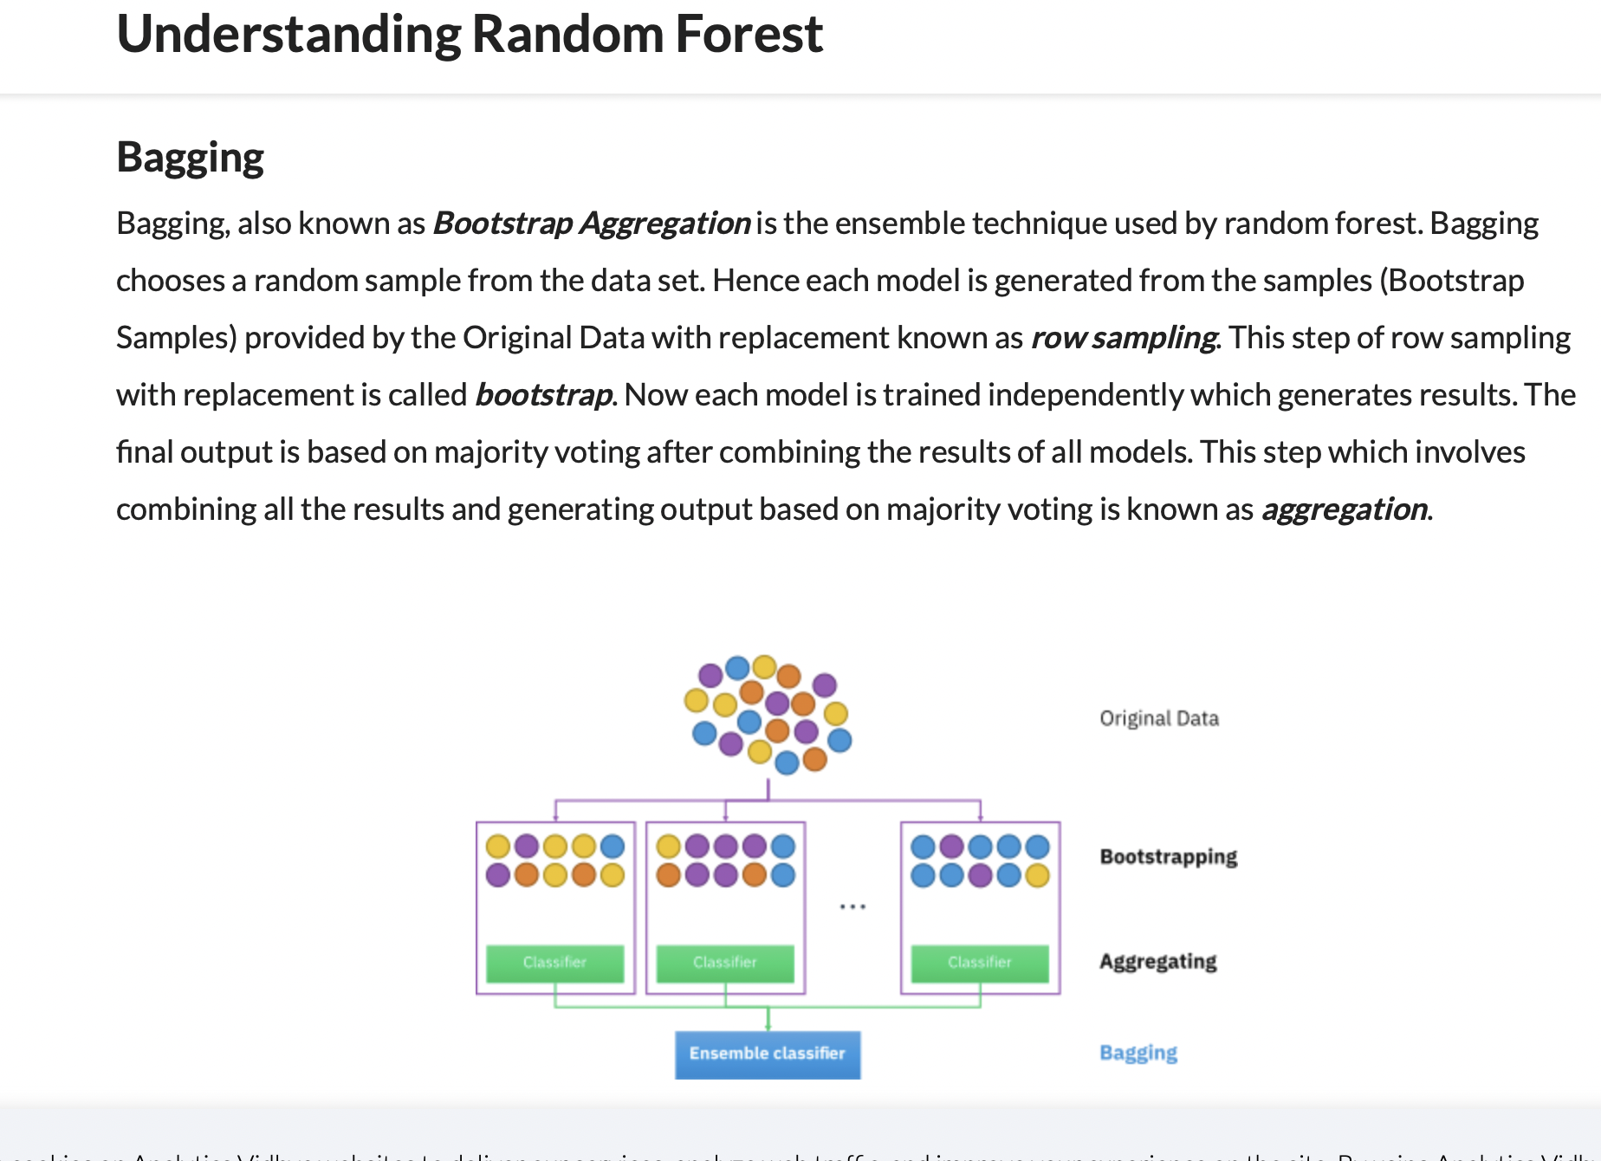
Notes:
https://www.section.io/engineering-education/introduction-to-random-forest-in-machine-learning/

Slide 52
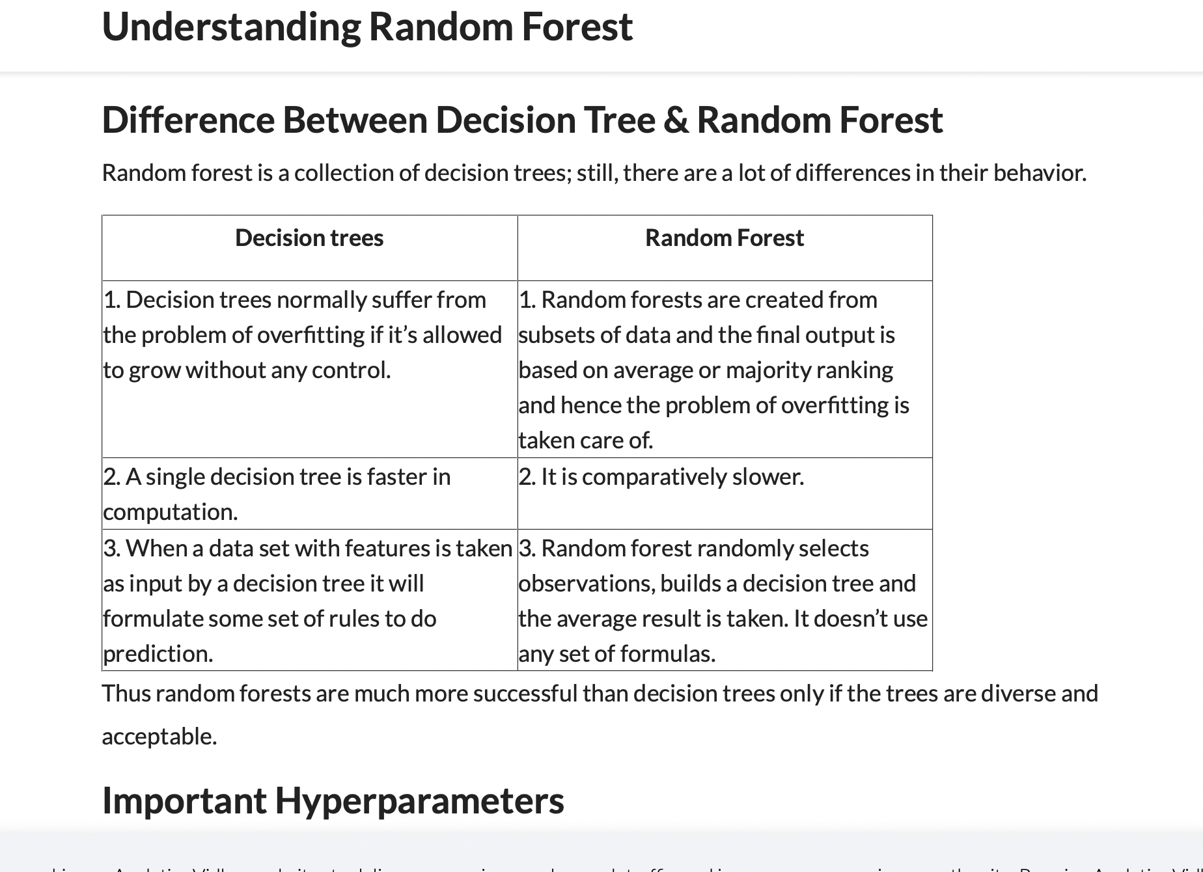
Notes:
https://www.analyticsvidhya.com/blog/2021/06/understanding-random-forest/

Slide 53
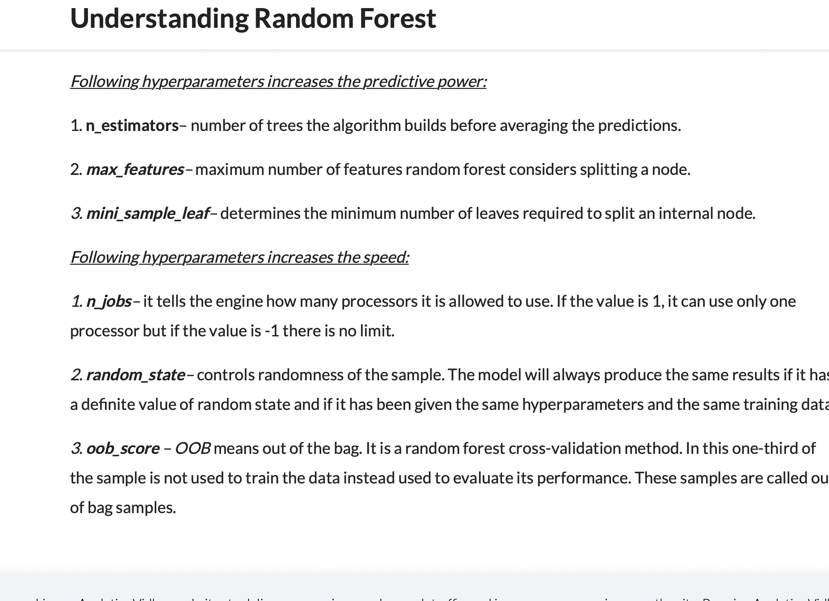

Slide 54
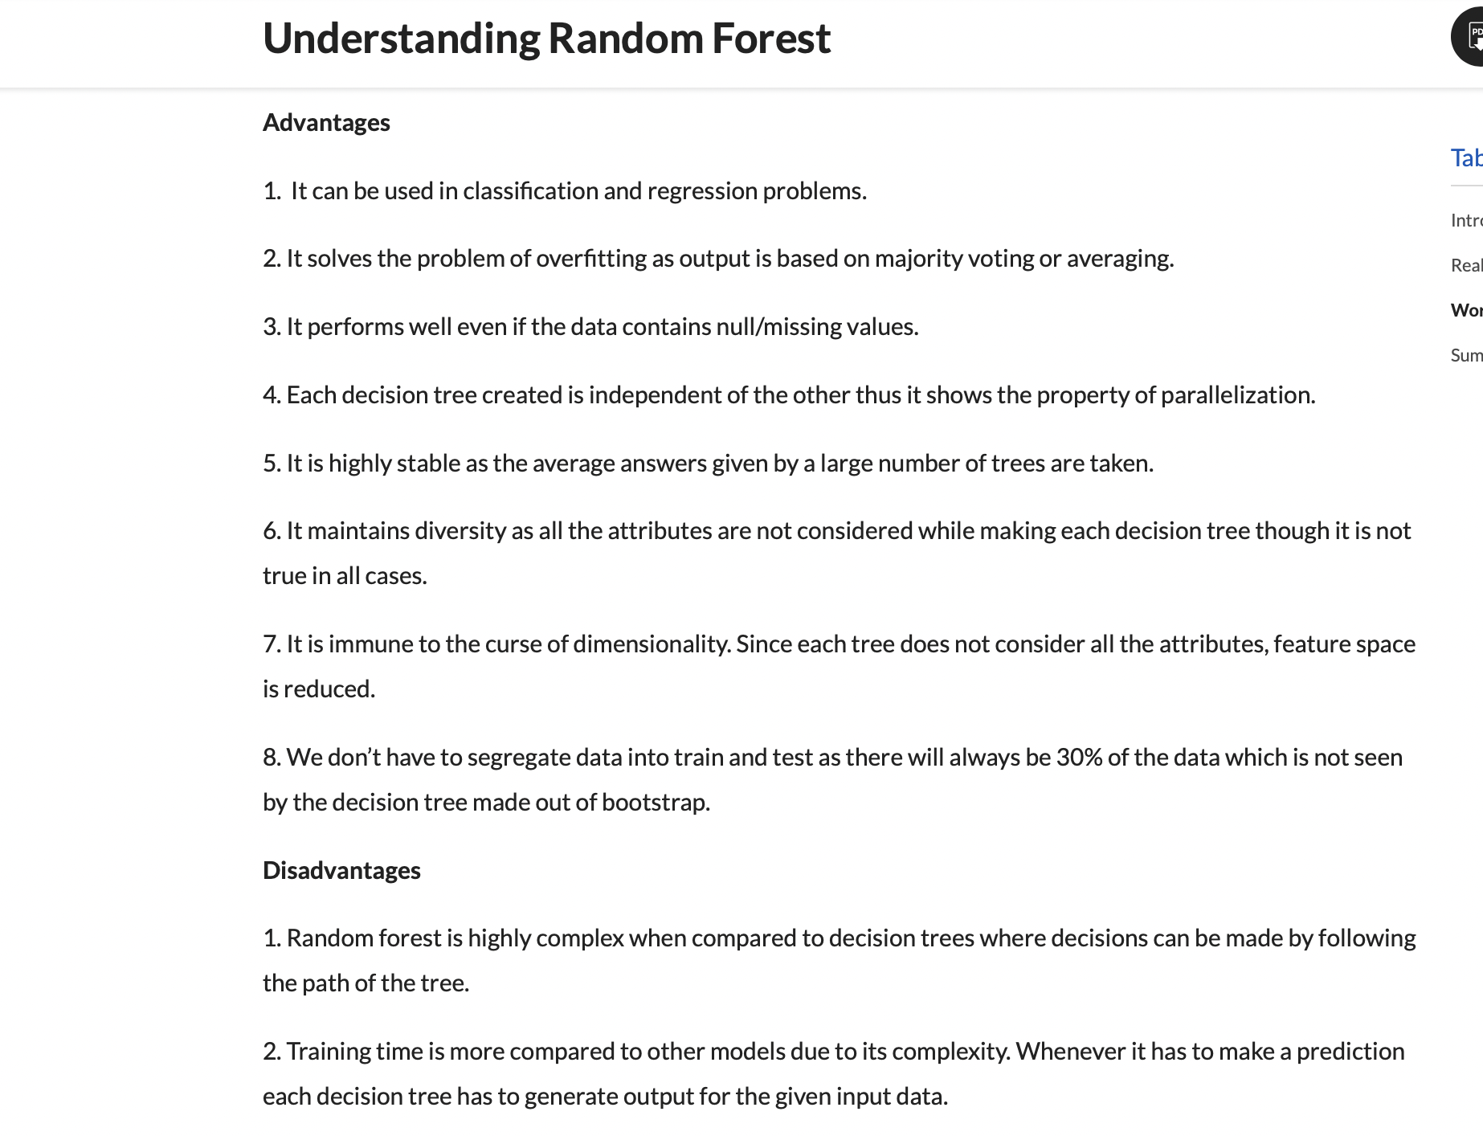

Slide 55
Boosting

Slide 56
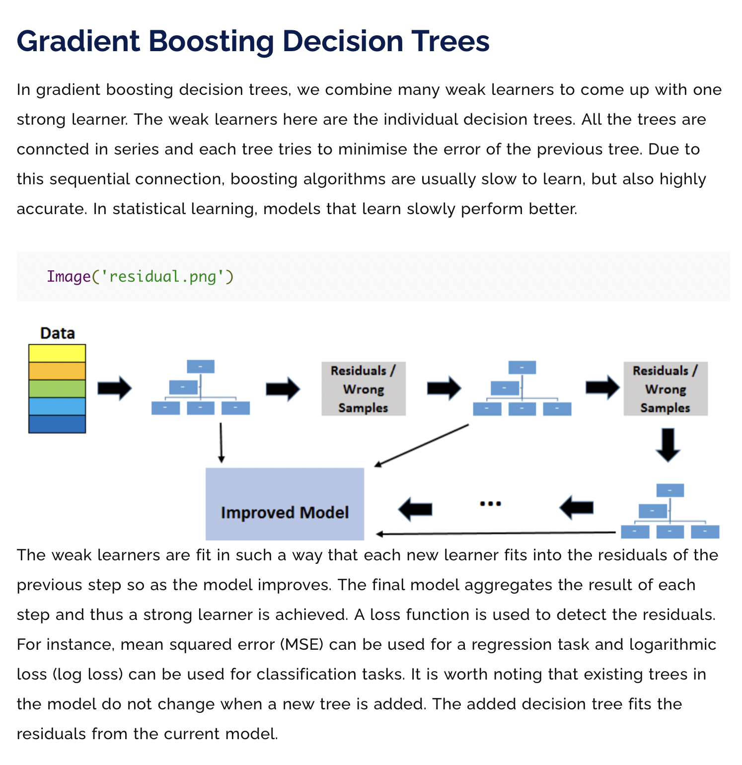
Notes:
https://www.machinelearningplus.com/machine-learning/an-introduction-to-gradient-boosting-decision-trees/

Slide 57
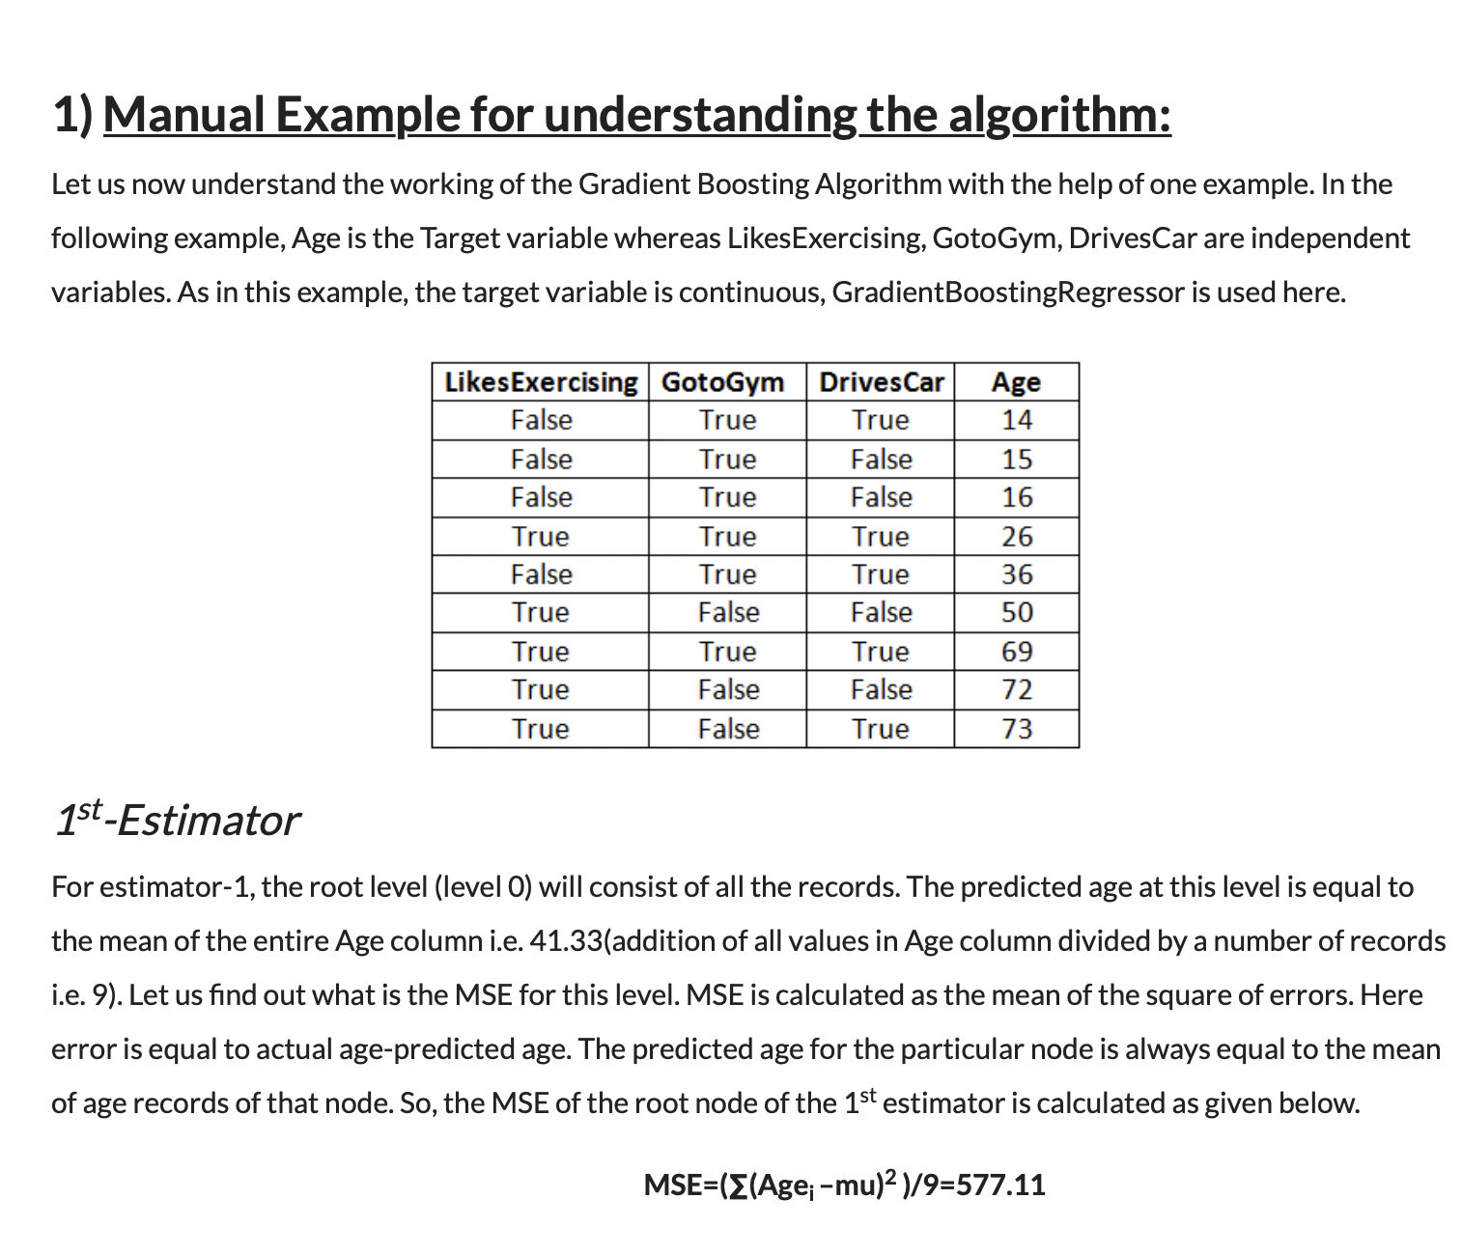
How the Gradient Boosting Algorithm works?
Notes:
https://www.analyticsvidhya.com/blog/2021/04/how-the-gradient-boosting-algorithm-works/

Slide 58
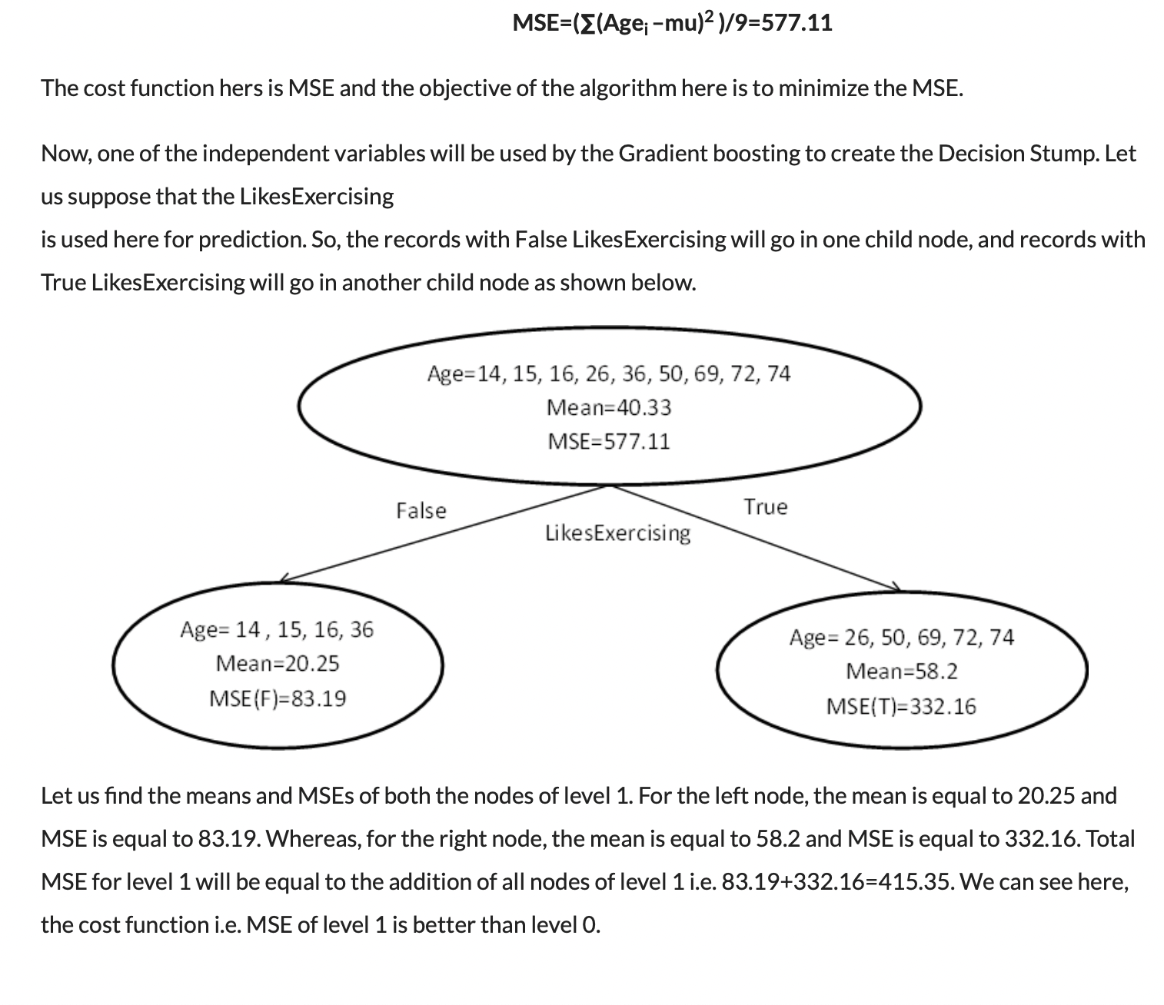

Slide 59
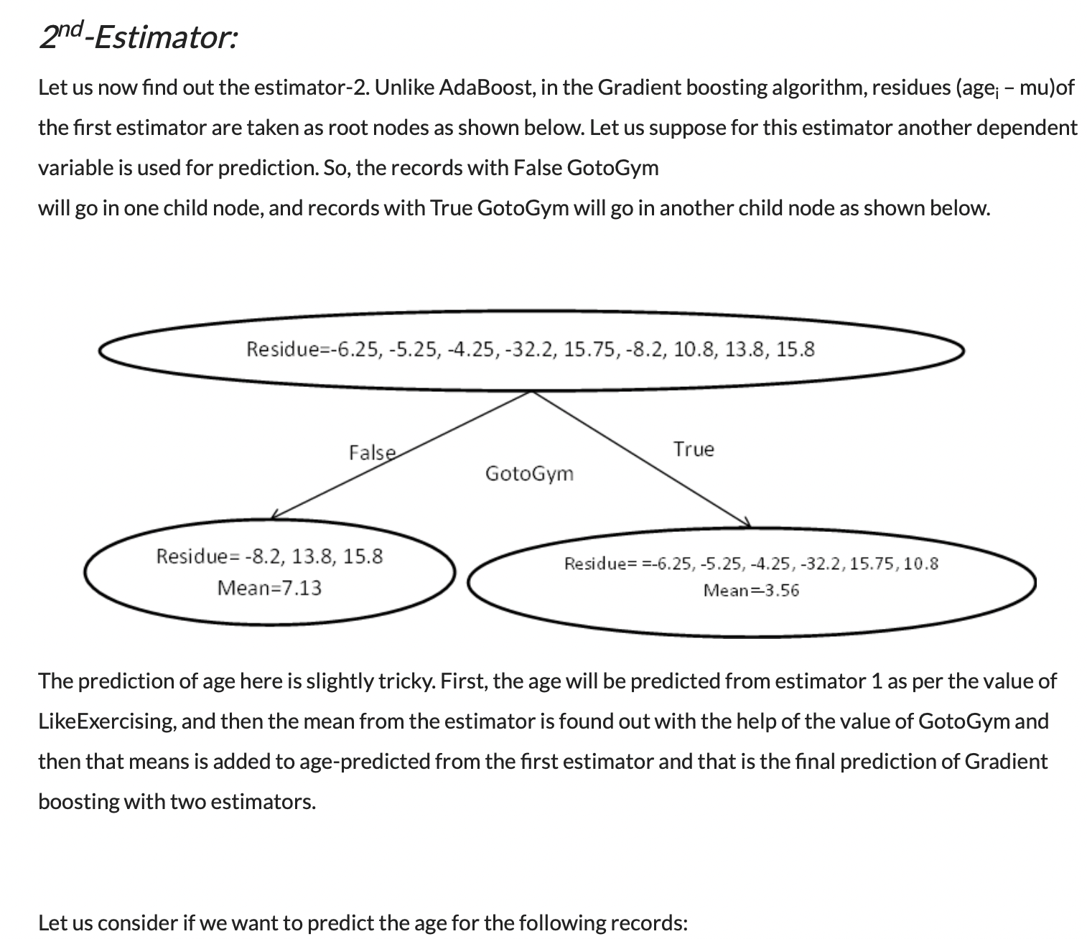

Slide 60
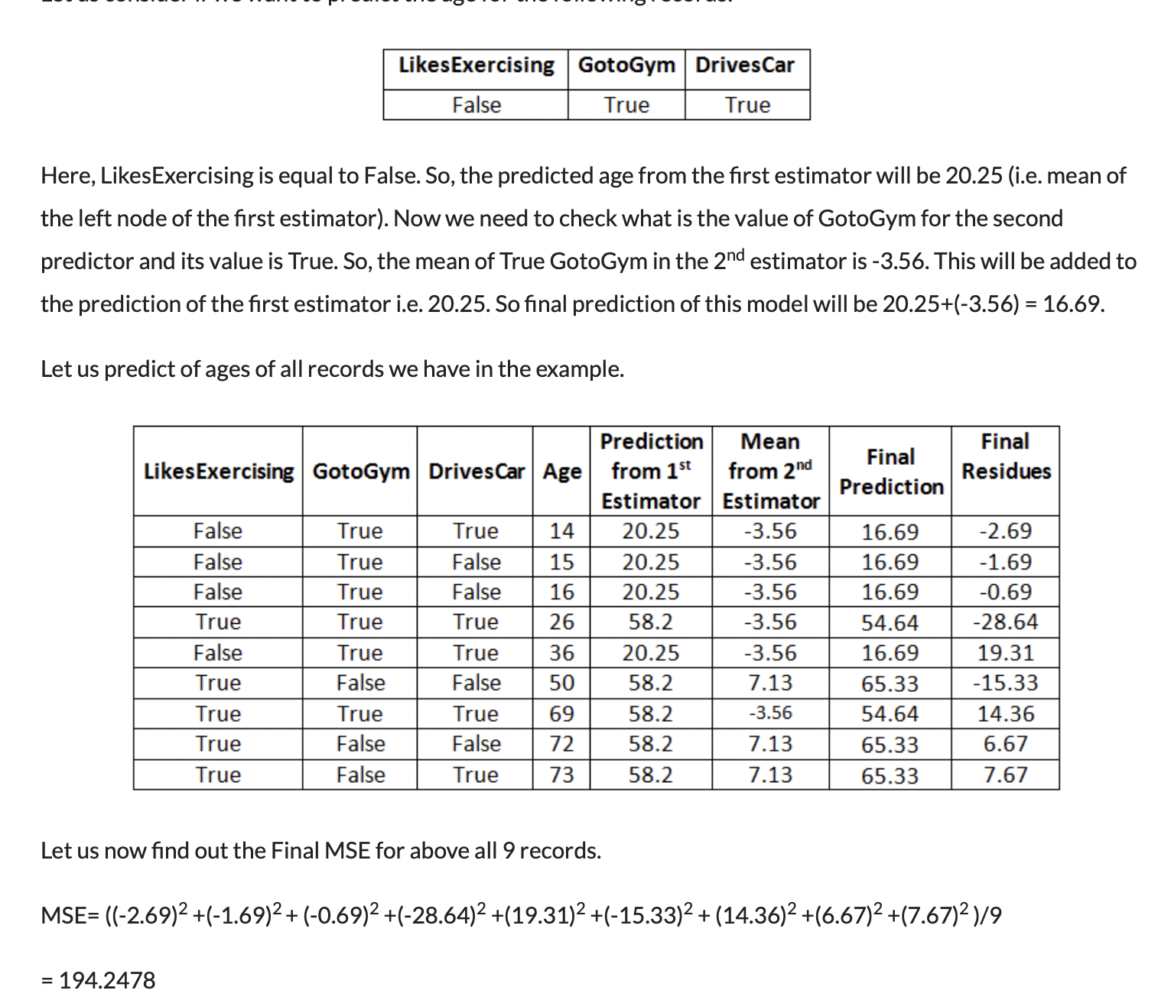

Slide 61


Slide 62


Slide 63


Slide 64


Slide 65


Slide 68
Evaluation and model selection

Slide 70


(Sensitivity)
Specificity= TN/(TN+FP)
Notes:
https://towardsdatascience.com/understanding-confusion-matrix-a9ad42dcfd62

Slide 71


Notes:
https://towardsdatascience.com/understanding-auc-roc-curve-68b2303cc9c5

Slide 72


Notes:
https://machinelearningmastery.com/fbeta-measure-for-machine-learning/
https://medium.com/@douglaspsteen/beyond-the-f-1-score-a-look-at-the-f-beta-score-3743ac2ef6e3

Slide 75


Slide 76


Slide 77


